Slide 1
Q Fund
Care Navigator Professional

Slide 2
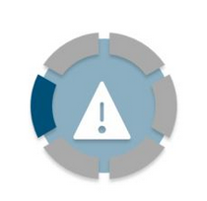
Why is this needed?
General Practice is changing
Chronic shortage of GPs in Forth Valley
No magic wand to create skilled ANPs to replace them
A growing multi-disciplinary team within each practice
But patients don’t know how to or don’t want to access them....

Slide 3
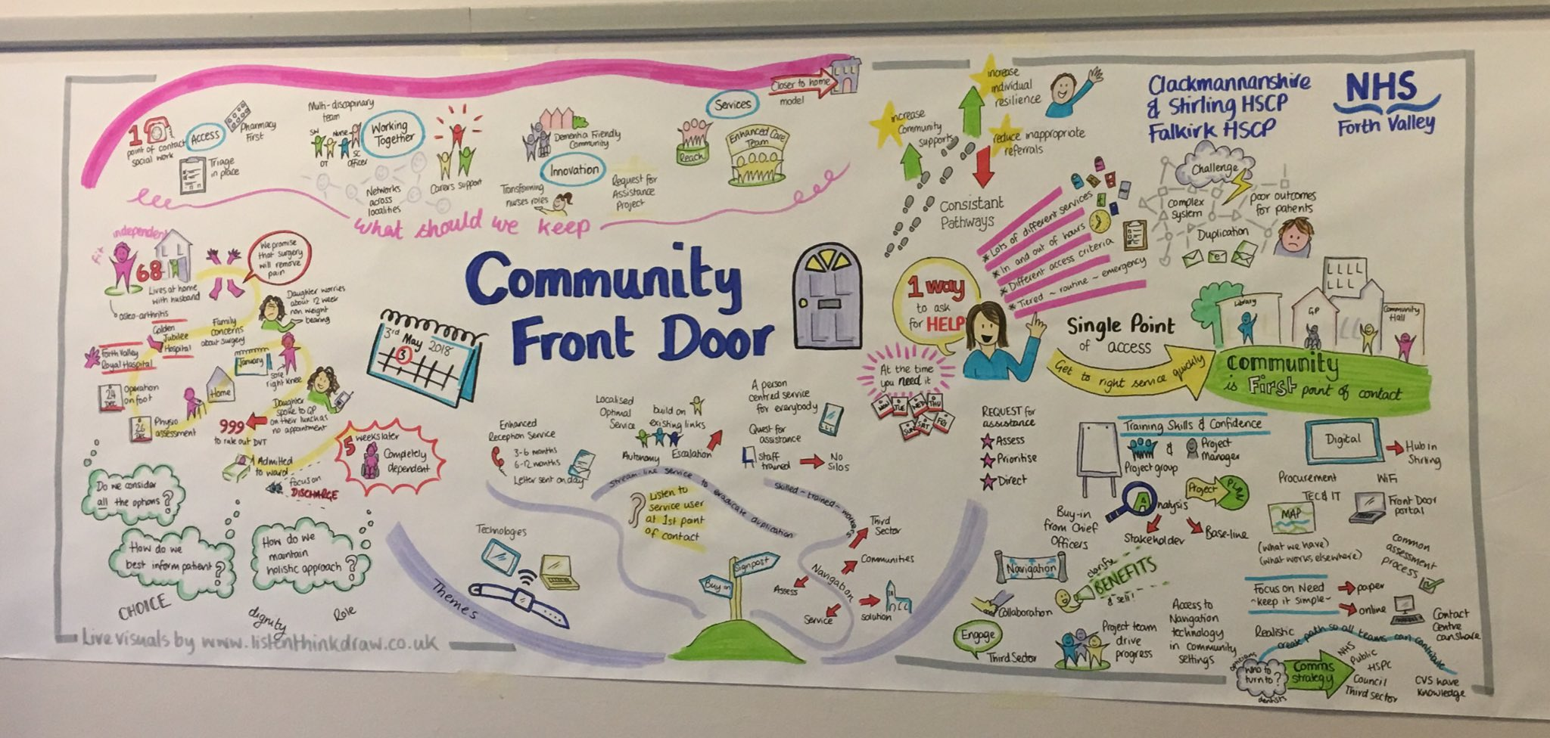
A strong case for this idea
Evidence base from community front door
Evidence base from PCTF

Slide 4
A strong case for this idea
Evidence base from PCTF

Slide 5
What’s already happening?
Lot’s of places and people to signpost to, but no one to do it
Link worker programme – great concept but no clear strategy for FV from gov’t
3 x clusters working on PASC to start small changes within practice and trial signposting methods
3 x HSCPs introducing tools to signpost
NHS Inform
ALISS

Slide 6
How will it lead to impact?
Patients will know that calling their GP practice would lead to support
This support could be in the form of an appointment with a clinician, or navigation to housing services, financial assistance, suicide prevention, a new walking stick
Forth Valley residents can access whatever they need through one simple portal

Slide 7
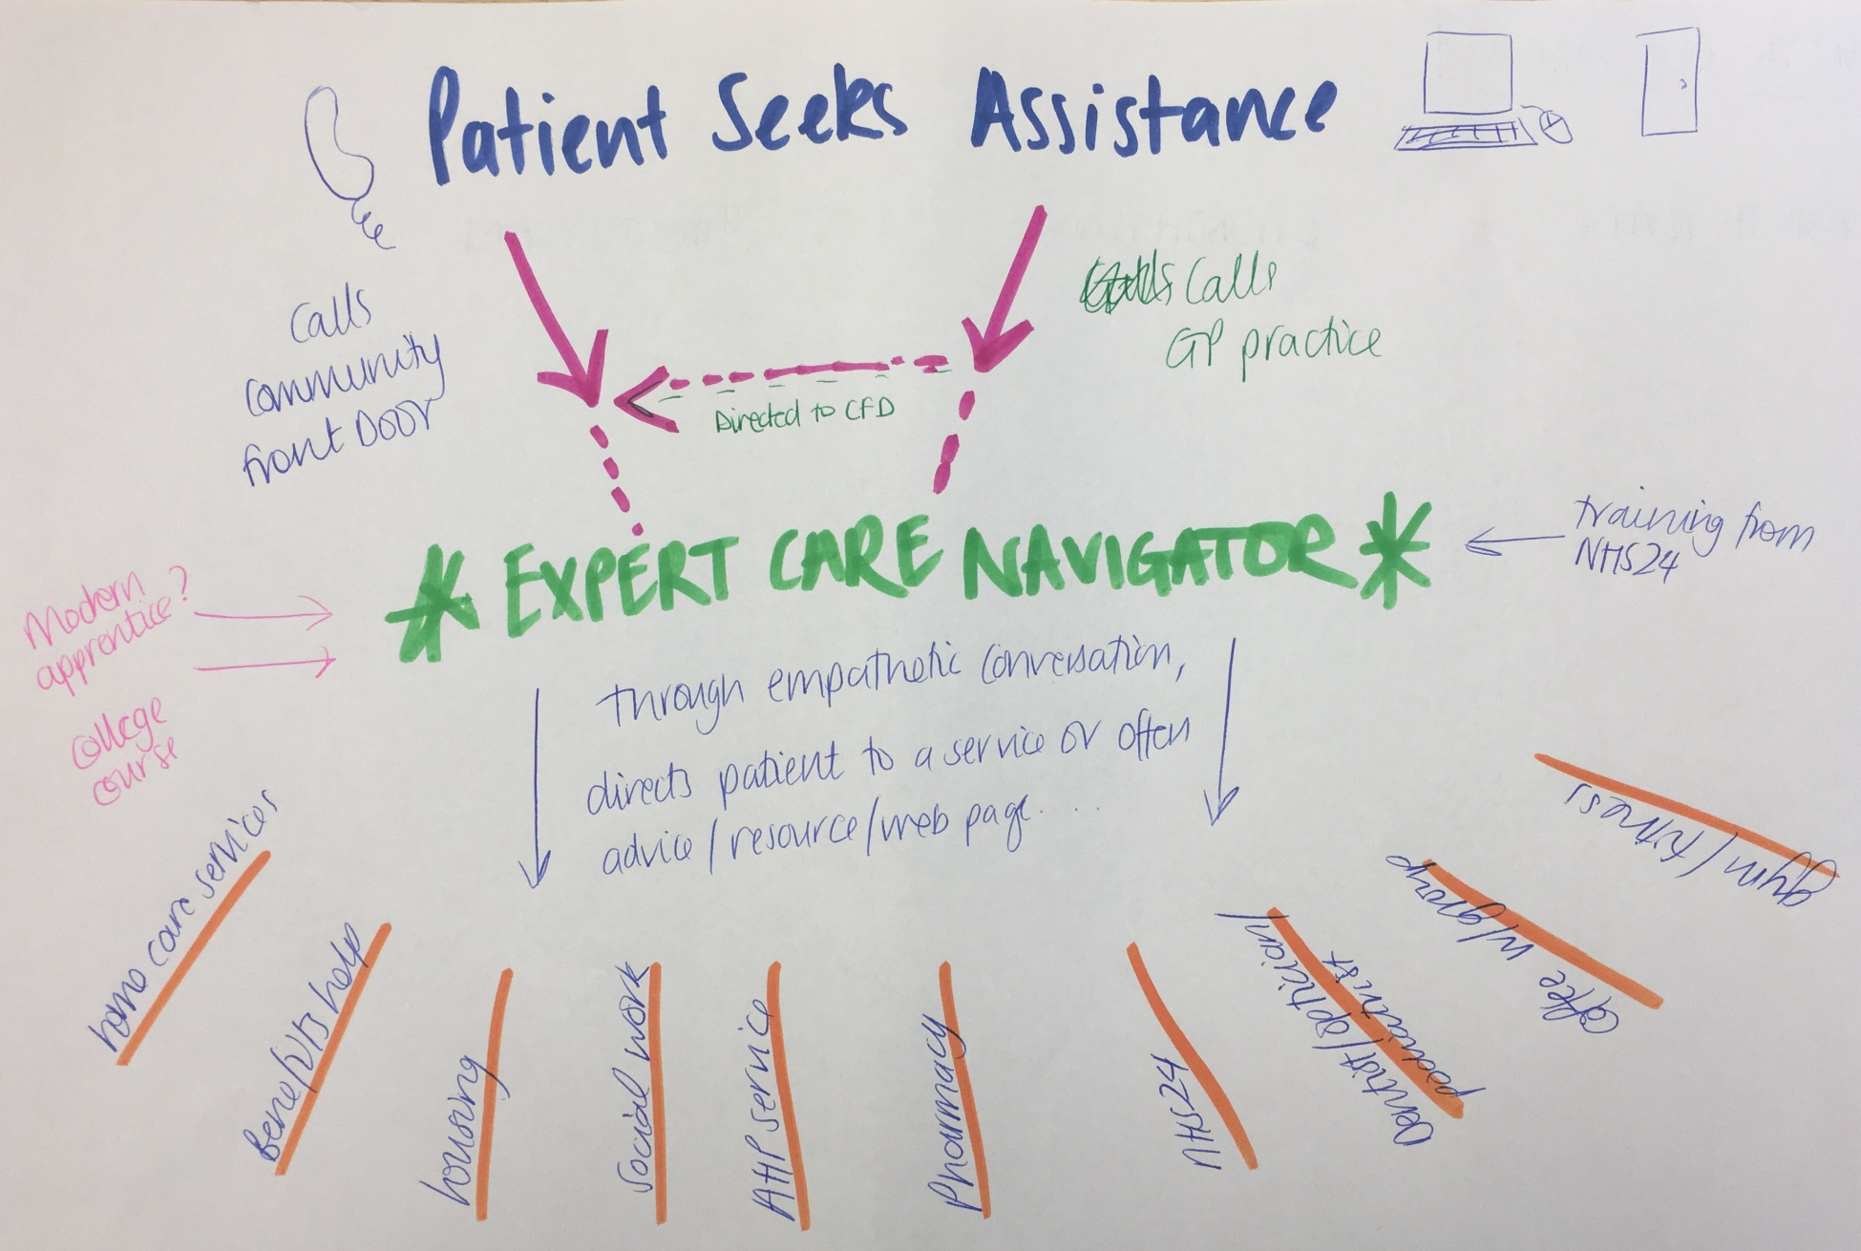
How will it lead to impact?

Slide 8
How will it lead to impact?
An expert care navigator is someone trained to help advise any request for assistance. This can be a GP receptionist.
Direct to:
Home care / care homes
Benefits / Financial help
Housing
Social work
AHP services
Pharmacy
Dentist / Optom / Podiatry
NHS24 / Ambulance/ MIU
Social groups in the area
Support charities
Physical activity

Slide 9
Giving back to the Q community
This is a nationwide issue
If a region has great primary care services, they may have poorly resourced housing
This joins up all services and provides a truly person centred service
Learning at every stage – feeding into the Q community and looking for input

Slide 10
The Team & the Plan
PASC team
Community Front Door team
HSCP
£30,000 = start by creating the skill base within GP practice admin staff
Starts as purely signposting to the appropriate service
As the CFD project grows, it can become a specific role; look to modern apprentices / college course etc
Pulling all of the work happening in the region into a central point – Q is non biased to health or social care.

