Slide 1
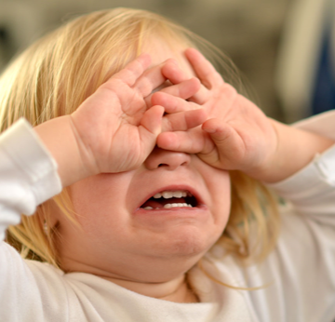
MAKE IT COUNT
Dr. Anne-Marie McClean,
ADEPT Clinical Fellow
Dr Mugilan Anandarajan
Linda Convery (Dietician)
Trudy Brown (Physio)
Dr Damien Bennett (PHA)
Sr. Karen Orr (OP Sister)
Dr. Jenny Thompson F2
Dr. Eamonn Sweeney ST4
Rodger Graham (Psychology)

Slide 3
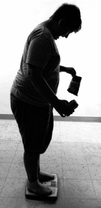
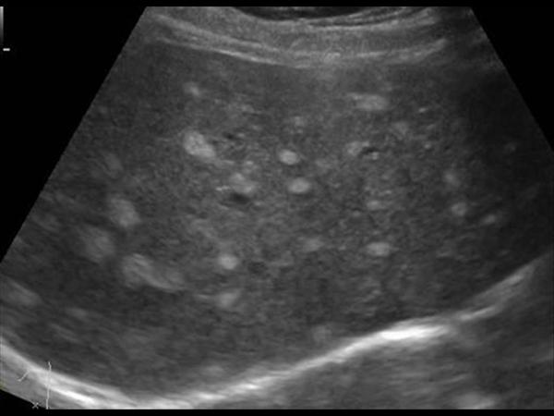
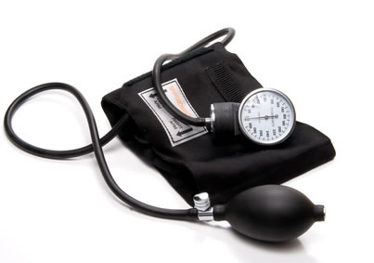
Background
Fatty liver disease
79% overweight children become overweight adults
Children only routinely screened for obesity twice through the NCMP
22% of P1 and 28% of P7 pupils in SEHSCT are obese or overweight
References:Northern Ireland Statistics and Research Agency. Overweight and Obese Children by Trust area- 2012 & N.Ireland Health Survey- published October 2017
Bullying, depression, anxiety
Hypertension

Slide 4
Background: N. Ireland State of Child Health Report 2017
“Make every contact count by having that difficult conversation with patients (regardless of age) who are overweight”
“ Increase the frequency of screening points”
“HSC Boards should commission services for children who are overweight or obese to lose weight”

Slide 5
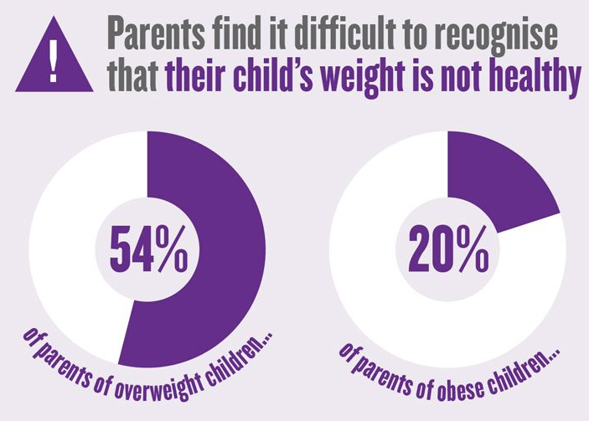
Literature Search
Poor recognition by parents & doctors of childhood obesity
Elk et al (2015): Only 20.4% of overweight/ obese children presenting to OPC were recognised.
UHD Audit 2017 : how many overweight and obese children were recognised in our paediatric OP?
*Elk et al, Archives of Disease in Childhood. Volume 100, Issue Supplement 3. 2015.

Slide 6
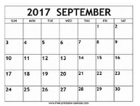
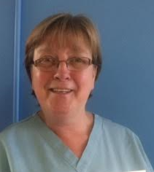
Ulster Hospital OP Audit
One week snapshot audit
General Paediatric Outpatient Population
Height & Weight collected
Retrospective BMI plotting performed
Clinic notes pulled & reviewed
PHA Collaboration
Comparison with NCMP data
Questionnaires

Slide 7
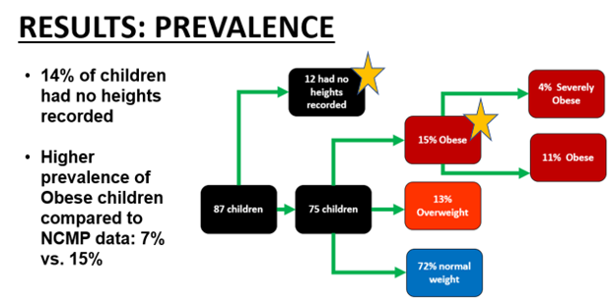

Slide 9
What did parents think?
100% of parents said the doctor seeing their child in OPC should recognise overweight/obese children & discuss this with parents
100% of parents believe healthcare professionals should receive specialist training to address childhood obesity

Slide 10
“If a doctor told me my child was overweight I would sit up and take notice”
“As long as I was done in a sensitive manner and assistance was offered then I would be open to it and listen”
“ There needs to be more resources for families”
“This is so important”

Slide 11
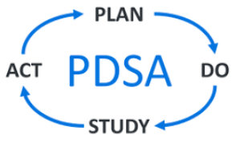
Make it Count
AIMS:
To increase recognition of obesity in children by ensuring that 50% will have BMI calculated & plotted by May 2018.
To increase staff awareness and knowledge regarding obesity
METHODOLOGY
IHI QI methodology & innovation to introduce routine BMI plotting into RRU & OPC

Slide 12
Outcome Measures
The % of children who will have their Body Mass Index calculated & plotted

Slide 13
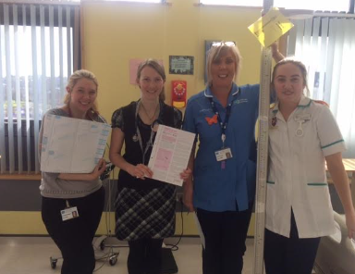
Process Measures
% of children who will have WEIGHT measured
% of children who will have HEIGHT measured
% of children will have BOTH HEIGHT AND WEIGHT PLOTTED
Staff Questionnaires & Focused discussion groups

Slide 14
Focused discussion groups & Questionnaires (45 doctors/nurses/HCPs)
I struggle & feel parents judge me on my own weight
As doctors we have NO TRAINING on how to tell parents their child is overweight
total lack of training for nurses on this issue
I’m a nurse and I just ignore it as I’m too embarrassed
It’s so awkward, the parents sometimes take it badly
I don’t want to hurt their feelings or give them an eating disorder
We are letting these children & families down
I fear the parents’ reaction
Notes:
Difficulty interpreting raw height & weight data
Lack of training
Time pressures
Fear of damaging doctor-family relationship
Lack of confidence
Unsure of where to signpost families & effectiveness of services

Slide 15
“ I weigh the children every day and I find it difficult when the child is clearly overweight. It can be very awkward and I don’t know what to do”
“In the evenings the only place for parents is to go to McDonalds. When parents ask me where is open I have to be honest”
Nursing Support Staff

Slide 16
“There is a complete lack of training on this-why are we taught how to break bad news but have no specific training on how to tell parents their child is overweight? I struggle with it. I don’t think I do a good job”
“There is a need to introduce routine BMI plotting for children- you can’t always tell by looking at the child”
Paediatric Trainee

Slide 17
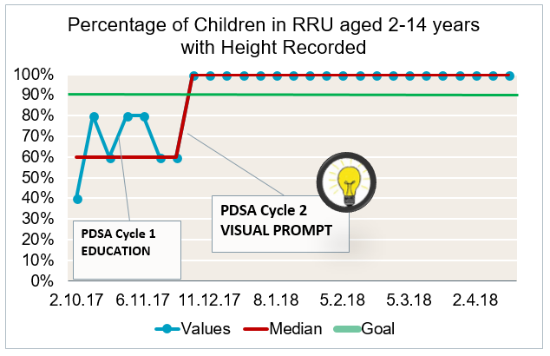
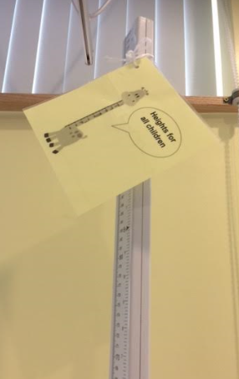
100% of children in RRU OP now have heights recorded

Slide 18
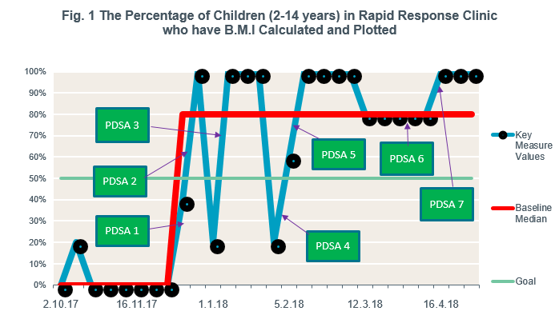

Slide 19
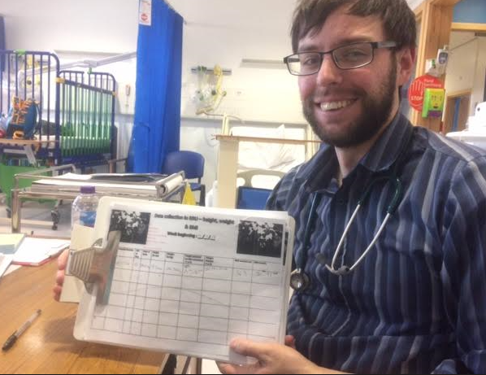
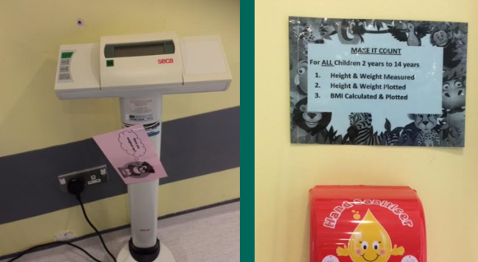
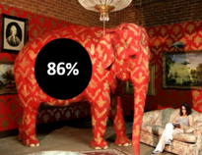
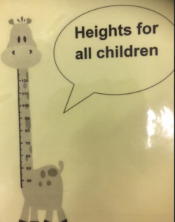
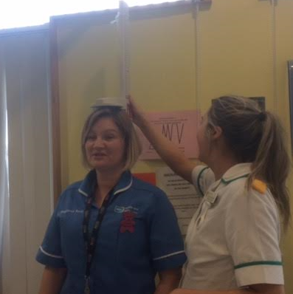
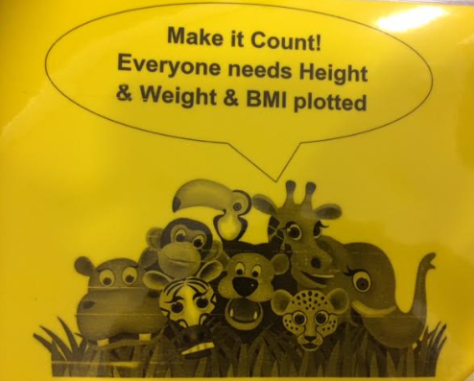
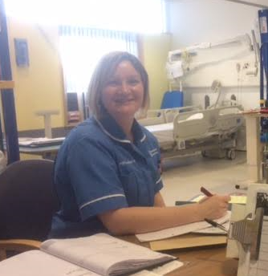
PDSA 1 Education & Awareness via email & presentations
PDSA 3
Visual Prompts
&
Reminders
PDSA 2 Individual Training in BMI Calculation & Plotting

Slide 20
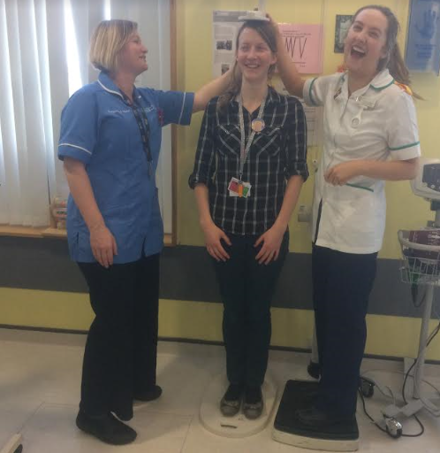
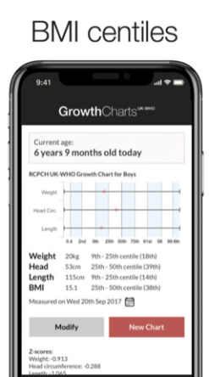
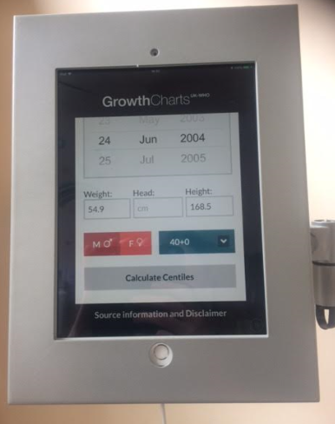
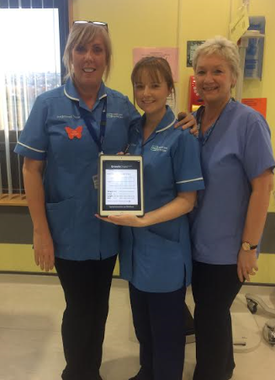
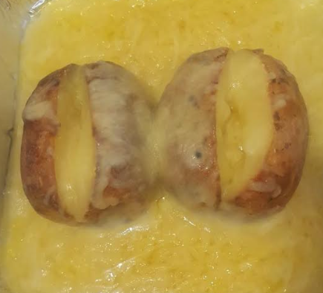
PDSA 4 Introduction of RCPCH app & IPADS
PDSA 5 Difficult Conversation Training
PDSA 6
Fun &
Games & CHAMPIONS

Slide 21
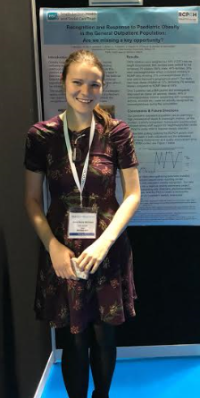
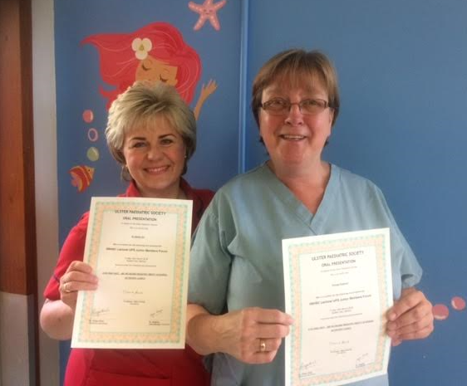
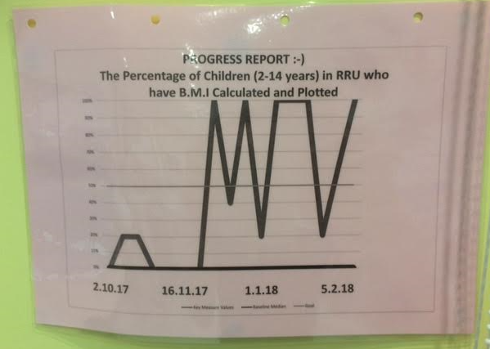
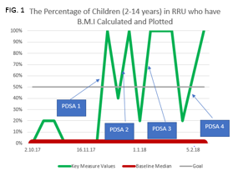
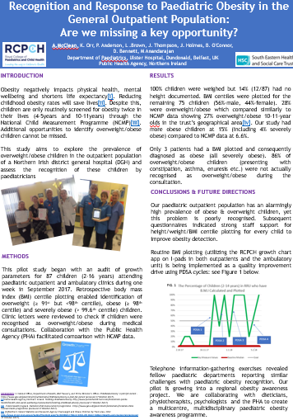
PDSA 8 Celebrating Success in May 2018
PDSA 7
Displaying Progress Reports
Ex: October to February 2018

Slide 22
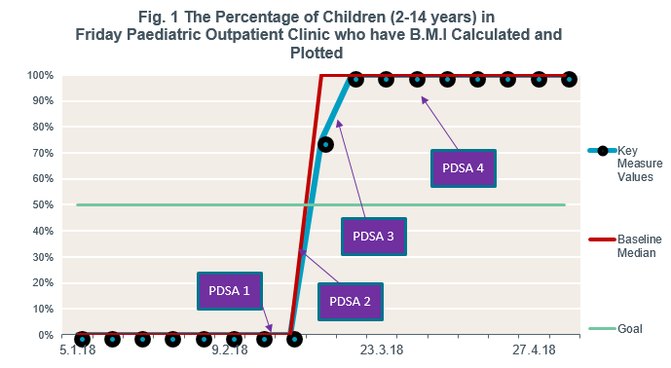

Slide 23
BMI plotting in Friday OPC

Slide 24
Balancing Measures: Response
Volume of dietician referrals
Signposting
Weight management resources
Increased clinic follow up
Staff training

Slide 25
Difficult Conversations Training
24 staff members attended
Doctors, nurses, healthcare professionals
20 questionnaires completed
All 20 questioned “agreed” or “strongly agreed” that the teaching session improved their CONFIDENCE and WILLINGNESS to address paediatric obesity with families
“ this training was really helpful and practical. It has changed my approach to the whole issue”
Paediatric Doctor

Slide 26
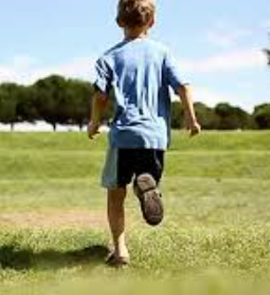
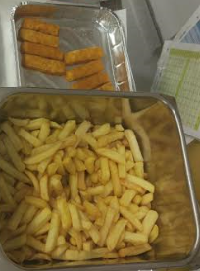
Next Steps?
Mum of 8 year old girl
“we will try anything. We would like to meet families in the same position”
FAMILY Obesity Service
Pilot 12 week course delivered by the Health Coaching Team for families of obese children w/ BMI > 98th centile
Ongoing staff training
More signposting resources to give to parents
Review of food we serve to children in hospital
Mum of 6 year old boy
“We are all struggling with weight as a family. We want to make changes but we need help”

Slide 27
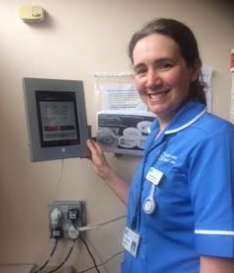
THANK YOU TO EVERYONE IN THE UHD PAEDIATRIC OUTPATIENT DEPARTMENT

