Slide 1
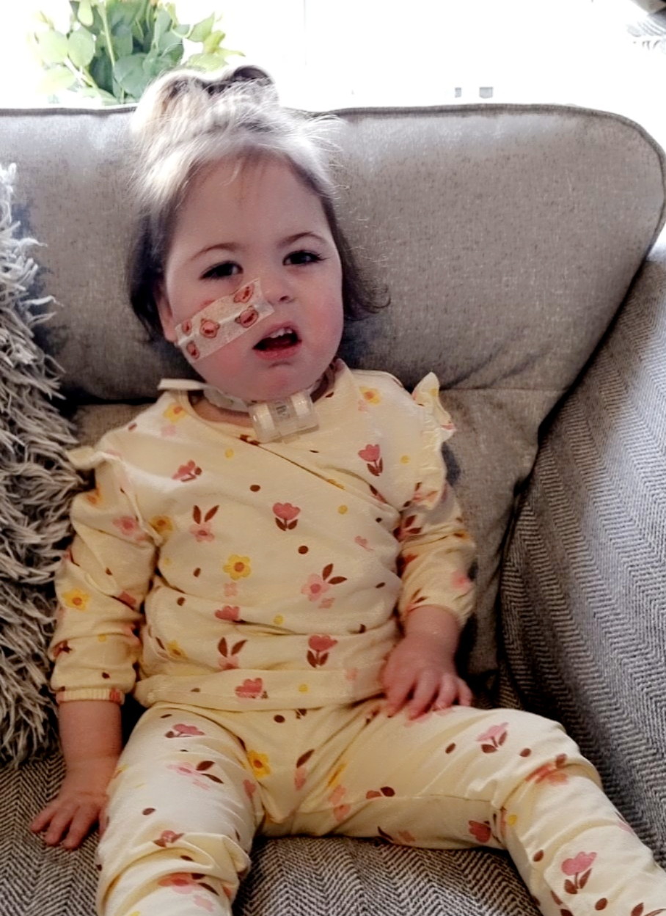
Competence, Confidence and Complex Needs
Community Children's Nursing Team SHSCT

Slide 2
Background All Community Children’s Nursing teams provide competency-based training for carers of children with nursing needs. Demand for training varies throughout the year and is not always available instantaneously.
Aim ​
To ensure just-in-time training, required for the safe care of children with nursing needs at home, school and in community settings, is engaging, easily accessible and expedites integration.​​

Slide 3
How can we achieve this?
We want to expedite hospital discharge and transition into school and community groups by providing a digital solution to the theory training currently provided.
It will be
Available 24/7 and will be backed up by face-to-face practical demonstrations.
Inclusive, meaningful, just-in-time training, making on-the-go learning a flexible and accessible reality.
A live database, with inbuilt triggers to ensure training and competencies are always in date.

Slide 4
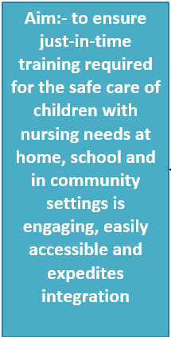
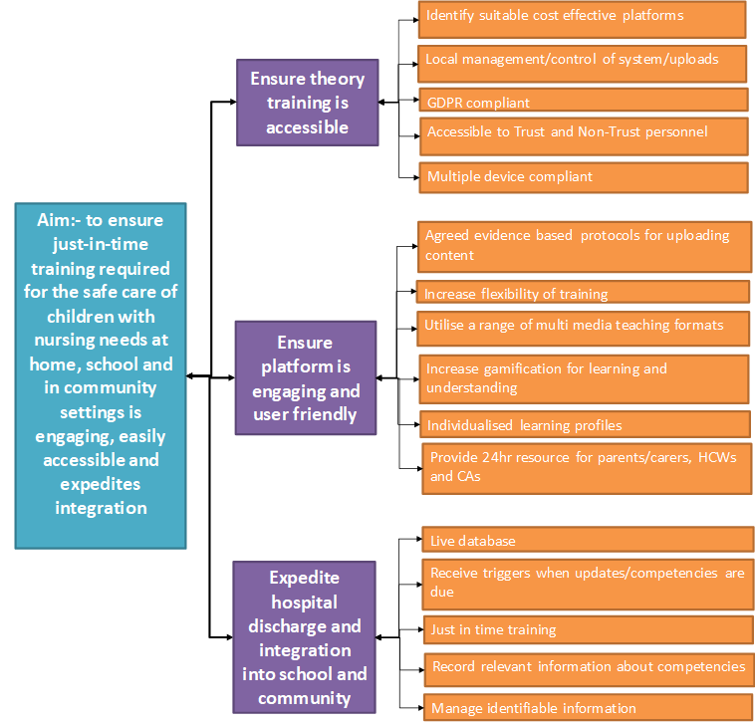
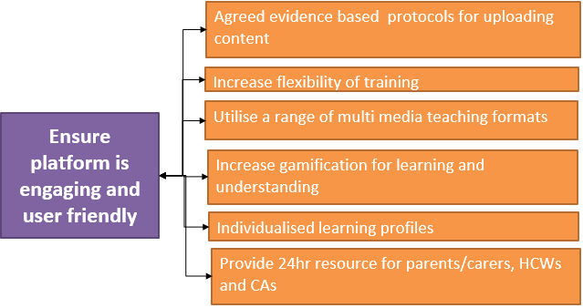
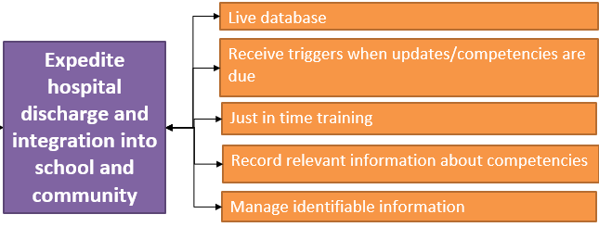
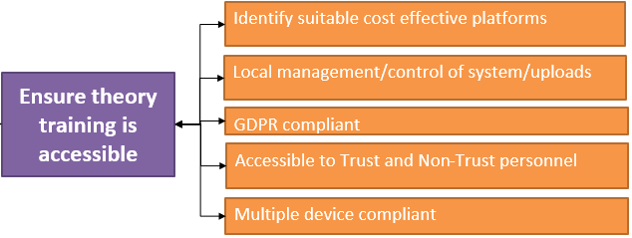
Driver Diagram

Slide 5
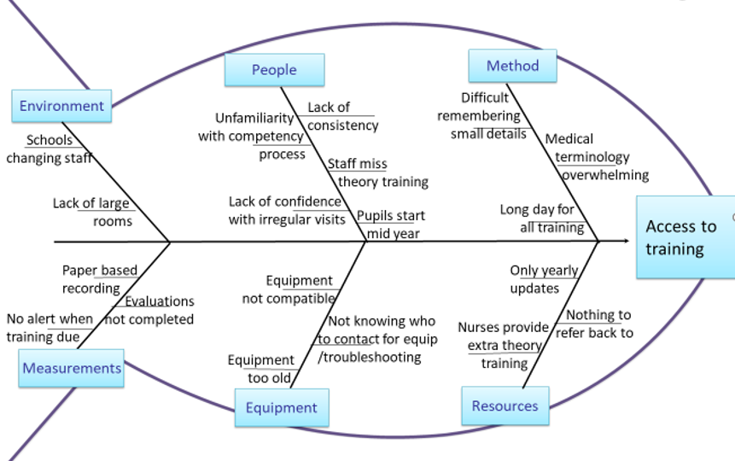
Frustrations from Stakeholder Meeting

Slide 6
Ideas generated by Stakeholder Meetings

Slide 7
Classroom Assistants Interested in online training
When surveyed following the traditional face-to-face training classroom assistants were overwhelmingly interested in online theory training.

Slide 8
Timeline
April – June 2023 Producing and collating learning material; Further Testing
August 2023 Launch; System in use by CAs, HCWs and Parents
August 2022 Evaluation of face-to-face theory training
September 2022 Engagement with Stakeholders
October 2022 Identification of Learning Management System (LMS)
November 2022 Analysis of Stakeholder Engagement
December 2022 Establish extra teaching sessions required for CAs; Identification of Animation software; Story boarding of initial video; Feedback from Stakeholders of first teaching animation video
January 2023 Testing of LMS and Animation Software together; Purchase animation software; Increase of Staff hours to dedicate time to project
February 2023 Feedback from Information Governance/Cyber security
March 2023 Testing of LMS by Stakeholders
July 2023 Final testing; Dissemination and demonstrations

Slide 9
PDSA Cycles
Tested
1 existing LMS for suitability
2 alternative platforms
3 alternative LMSs
4 animation software
5 video produced with animation software
Result
Not appropriate
FutureLearn and Moodle not appropriate
RISE.com and Docebo were not suitable
Talent LMS appears suitable for use pending Information Governance and Cyber security approval
Easy to Use
Stakeholders liked video but preferred natural voice of presenter

Slide 10
Learning so far
The Value of:-
stakeholder involvement from the start
attending Action Learning Sets and QExchange workshops
talking to local businesses to see how they have solved similar challenges
strengthening relationships between Education Authority and Health and Social Care
teamwork
Importance of Information Governance and Data Flow
How Quality Improvement works
The overwhelming support from stakeholders for online training
The considerable interest from other CCN Teams and other specialties and their wish to be included in future developments

Slide 11
Next steps
Test LMS and refine
Create learning videos
Evaluate improvement
Publish the learning and process
Share online training regionally with CCN Teams
Share and adapt for other specialties within SHSCT

