Slide 1




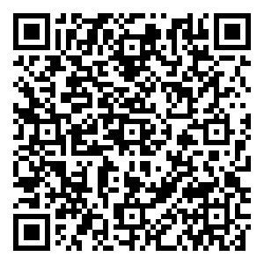
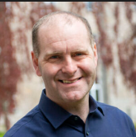
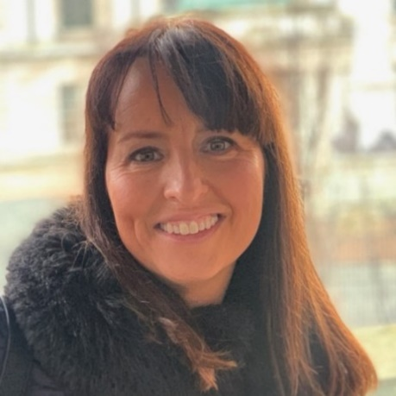
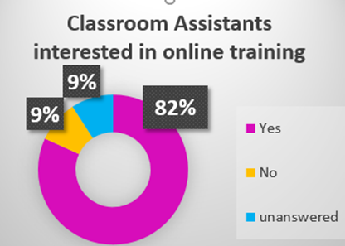

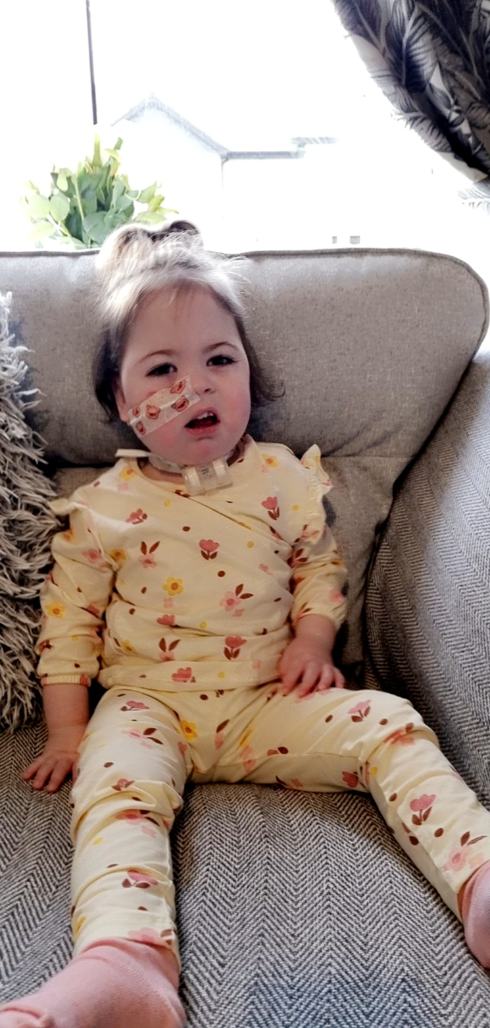

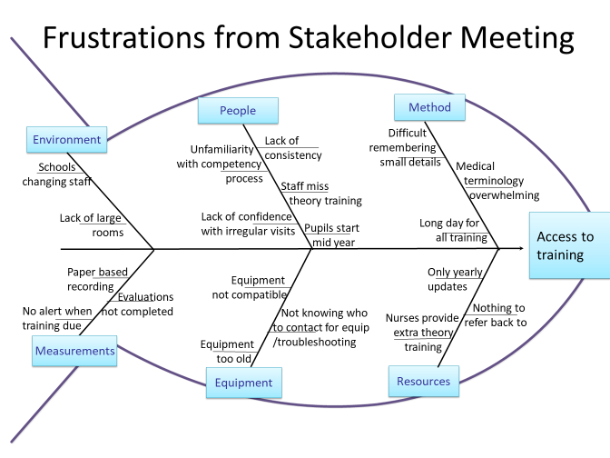
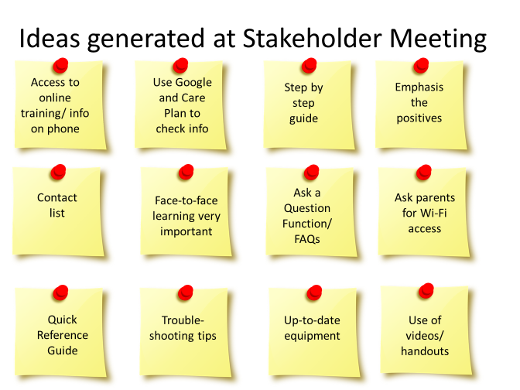

Competence, Confidence and Complex Needs
Contact: Una.Hughes@southerntrust.hscni.net
Contact: Julianne.Lee@southerntrust.hscni.net
Contact: Gerard.Enright@southerntrust.hscni.net
Project Team
Una Hughes Children’s Nursing Services Training Coordinator
Julianne Lee Lead Nurse Community Children’s Nursing
Gerard Enright Quality Improvement Lead
AIM
To ensure just-in-time training, required for the safe care of children with nursing needs at home, school and in community settings, is engaging, easily accessible and expedites integration.
THE PROBLEM
DRIVER
DIAGRAM
Problems
Solutions
Evidencing the need for improvement
Learning Management System (LMS) used in Trust only suitable for Trust staff
Relatively small numbers initially
Concerns about Information Governance and GDPR
Control over videos, flexibility to modify quickly at low cost
Subscribe to LMS which will permit non-Trust staff users
Choose LMS which meets all criteria but is flexible for growth
Discuss with Trust Governance and investigate compliance
Purchase user friendly animation software subscription
Annual theory training is provided for classroom assistants (CA) and healthcare workers (HCW) but due to changing circumstances further training is frequently required for small numbers of staff.
RATIONALE
To improve access to theory training, consistency of competency checks and alert managers when training updates are required.
24/7 access to theory training for CAs, HCWs and Parents will assist them to competently and confidently care for children with complex needs.
To support the child’s timely integration into school, community and home life through safe delegation.
To find out more about our Q Exchange Project please scan the QR code
PROCESS
Development of Online Training Programme
NEXT STEPS
Stakeholder Engagement
Test LMS and refine
Create learning videos
Evaluate improvement
Publish the learning and process
Share online training regionally with CCN Teams
Share and adapt for other specialities within SHSCT
Engagement with CAs, HCWs and Parents
Engagement with CCNs locally and senior management in Southern Trust
Close working relationships with Special and Mainstream schools
Liaising with Trust Governance and IT
Evaluation of training process already in place and interest in online learning
Goal was to set up online learning with competency database
Design and animate training videos.
Identify user friendly software for animation
Subscribe to cost effective LMS that everyone could access
Outcomes:
LMS identified
Animation software identified
Learning:
Parents in stakeholder group very keen to have training they could access
Stakeholder group identified areas to work on that Project team hadn’t considered e.g. “Ask a Question” function.
Thank you to our poster girl, Elsie

