Slide 1
Q LS User Group
virtual meetup
8 September 2022

Slide 2
Welcome + workshop purpose
To trial structures
To use meetup principles
To share approaches to virtual adaptations
To support the growing network of Q LS users
*please introduce yourself in the chat*

Slide 3
What are Liberating Structures?
Simple social workshop designs that distribute participation more widely, while drawing out greater difference and variation within groups
A repertoire of techniques that reliably generate novelty
A collection for organising groups to collaborate and mutually shape their work together
Tools & facilitation techniques that share a similar logic or organising structure
Tiny methods that make it possible to benefit from complexity instead of flattening, ignoring, and pushing it away

Slide 4
Plan for today
Impromptu Networking
Min Specs

Slide 5
#liberatingstructures

Slide 6
#liberatingstructures
Open to all
Next meet up: 20th September
Ecocycle planning
Follow us on twitter (@liberatingstru1) and DM your email to get added to mailing list

Slide 7
#liberatingstructures
Today’s Meet Up
Impromptu networking
Min Specs

Slide 8
Impromptu Networking
What is it?
Allows rapid networking – especially at the start of an event.
Loose yet powerful connections are formed by asking engaging questions.
How to do it
We have adapted this liberating structure to suit digital.
“What is uppermost in your mind today?”
Learn more: https://www.liberatingstructures.com/2-impromptu-networking/

Slide 9
Impromptu Networking
‘What is uppermost in your mind today?’
2 minutes
2 minutes
2 minutes
Learn more: https://www.liberatingstructures.com/2-impromptu-networking/
Notes:
Jonathan 0 add another couple

Slide 10
Min Specs
A designer knows perfection is achieved not when there is nothing more to add but when there is nothing more that can be taken away. – Antoine de Saint-Exupery
What is it?
By specifying only the minimum number of simple rules, the Min Specs that must ABSOLUTELY be respected, you can unleash a group to innovate freely. Respecting the Min Specs will ensure that innovations will be both purposeful and responsible. Like the Ten Commandments, Min Specs are enabling constraints: they detail only must dos and must not dos. You will eliminate the clutter of nonessential rules, the Max Specs that get in the way of innovation.
How to do it?
In the context of a challenging activity, a new initiative, or a strategic bottleneck, invite the participants to first generate the entire list of all the do’s and don’ts that they should pay attention to in order to achieve a successful outcome. This is the list of maximum specifications (Max Specs)
After the list of Max Specs has been developed, ask the participants to reduce it to the absolute minimum needed to achieve their purpose. Invite them to sift through the list one item at a time and eliminate every rule that gets a positive answer to the question, “If we broke or ignored this rule, could we still achieve our purpose?”
Learn more: https://www.liberatingstructures.com/14-min-specs/
Notes:
Drop the link in the chat:
https://www.liberatingstructures.com/22-celebrity-interview/

Slide 11
Min Specs
2-3 min
Make individual lists of characteristics
5 min
Consolidate/theme lists of characteristics
15 min
Narrow list of characteristics. Ideally 3-5 must dos.
Repeat as necessary
Notes:
NOTE: Preferred content slide for webinars to ensure consistency across the SPSP Programmes.

Slide 12
What are the minimum specifications required for owning and running an electric car?
Notes:
Drop the link in the chat:
https://www.liberatingstructures.com/14-min-specs/

Slide 13
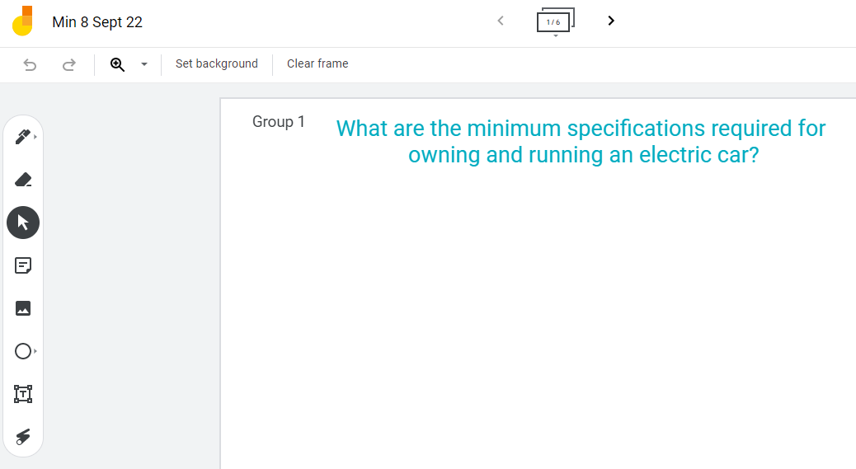
How to use Jam Board
Opening the link and find your group
Or
Notes:
Joriam - set up Jam Board

Slide 14
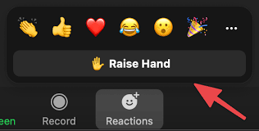
Feedback
What has … identified for you and how did this help you?
Type your answer in the chat
Don’t hit send
3, 2, 1 Countdown…hit send
3…
2…
1

Slide 15
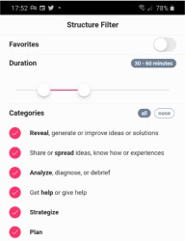
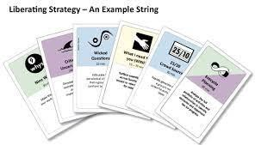
Thank you, feedback & next date
Please share your feedback on this session: https://survey.eu.qualtrics.com/jfe/form/SV_41PrkCWH4R04flA
Get involved – help facilitate a future session?
Join Q’s ‘Liberating Structures in Healthcare’ group: https://q.health.org.uk/community/groups/liberating-structures-in- healthcare/
Next met up of the SIG: 6th October 2022 @ Midday
Find the right LS to use with LS Matchmaker tool LS cards pack; LS App

