Slide 1
Q LS User Group- virtual meetup (February 2023)
‘Zoom in the time of Liberating Structures’
Notes:
Kristin

Slide 2
Welcome + workshop purpose
To support the growing network of Q LS users - *please introduce yourself in the chat*
To try structures in a virtual space
Use meetup principles
Notes:
Kristin

Slide 3
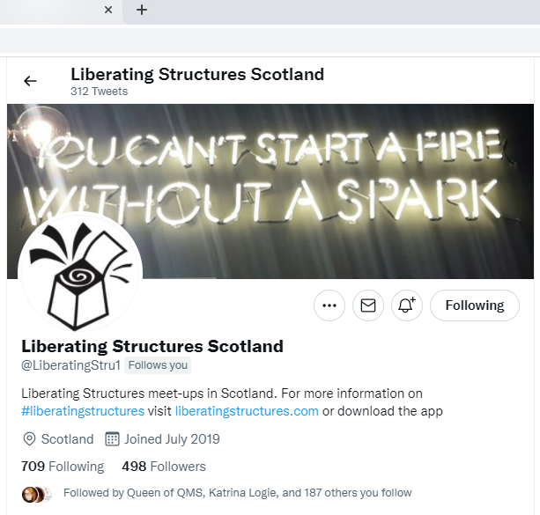
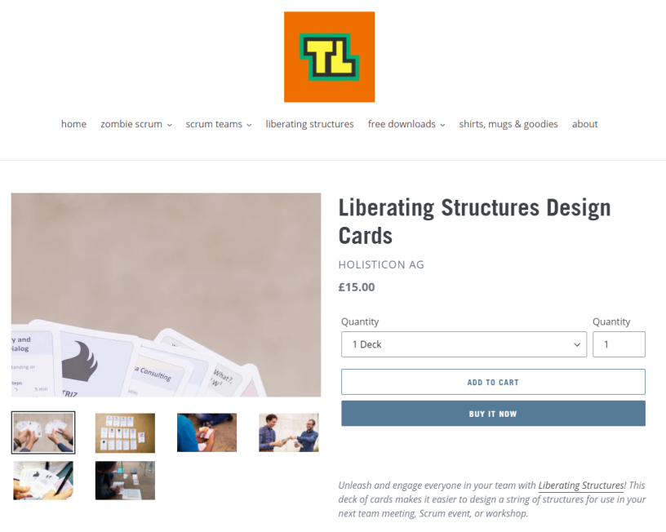
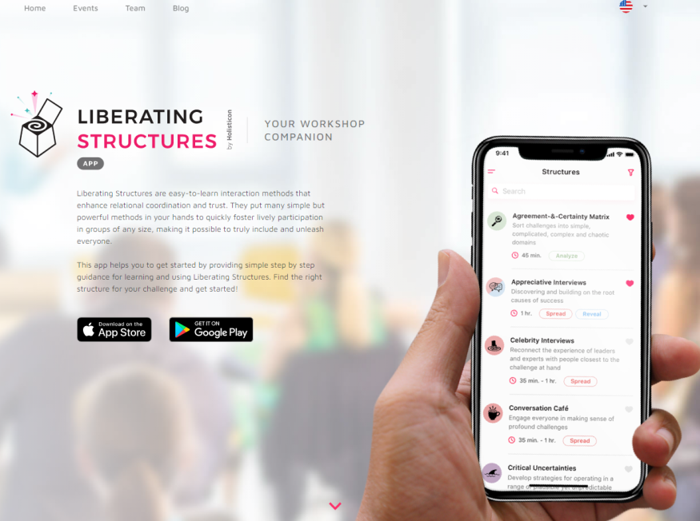
Book
Website
Twitter
Cards
App
Notes:
Kristin

Slide 4
Today’s meet up:
Shift and Share
Spread good ideas, make informal connections
and surface hidden experiences and wisdom from peers
Notes:
Ronan

Slide 5
Today’s Theme:
Shift and Share
Reflections From the NHS
Notes:
Ronan

Slide 6
Can be used for:
Reflection
Joy in Work
Planning
Evaluation
Notes:
Ronan

Slide 7
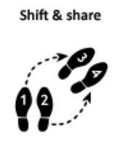
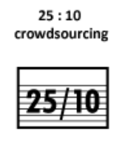
Suggested String
Helping to create space and an atmosphere of reflection and exploration.
Notes:
Ronan

Slide 8
Peer presenters:
Room #1 - James Gilpin
Room #2 - Sophia Moody
Room #3 - Des Brown
Room #4 - Briege McCann
Notes:
Ronan

Slide 9
Steps and Timing
Preparation
Invited 4 presenters to share for 8-10 minutes about a specific topic
Joriam will divide all attendees randomly into 4 breakout rooms that will be your learning group for the whole meet up
At the end of each round, your learning group remain in your breakout room and Joriam moves the presenters to a different room.
Start Round 1
Presenters have 10 minutes with each group. Suggestion: 6 min max for sharing and 4 min for questions and comments.
Joriam will send a 4 minute and 1 minute warning to signal that the round is about to end
Joriam will move the presenter to a new breakout room where they will repeat their presentation to a new group
And so on for 4 rounds
After 4 rounds we debrief as a whole group
Notes:
Ronan
Sharing topics: “ your insights on a challenging time in your career that had a positive outcome”.
Or “ an innovation you have implemented, your key learning, challenges and outcomes”.

Slide 10
Debrief
What did learn today….. and how or where
could you use shift and share in the next few months?
Type your answer in the chat
Don’t hit send
3, 2, 1 Countdown…hit send
3…
2…
1
Notes:
Kristin

Slide 11
Closing
Thanks to today’s volunteers
Please share your feedback on this session
Come back or facilitate a future session
Join Q’s ‘Liberating Structures in Healthcare’ group: https://q.health.org.uk/community/groups/liberating-structures-in- healthcare

