Slide 1
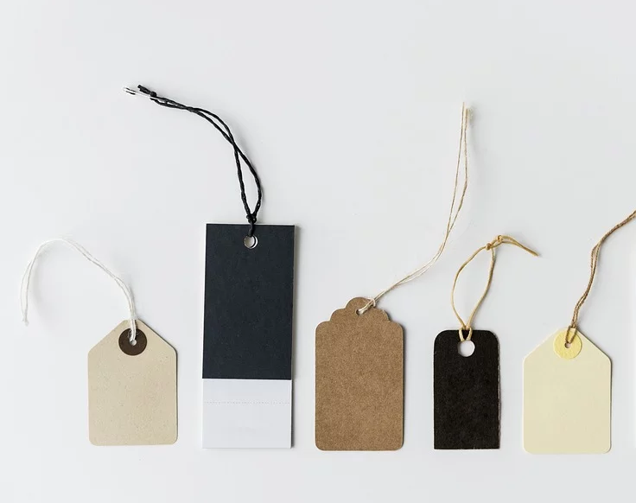
Liberating structures Wise Crowds
Attribution: Liberating Structure developed by Henri Lipmanowicz and Keith McCandless. Inspired by Quaker Clearness Committees

Slide 2
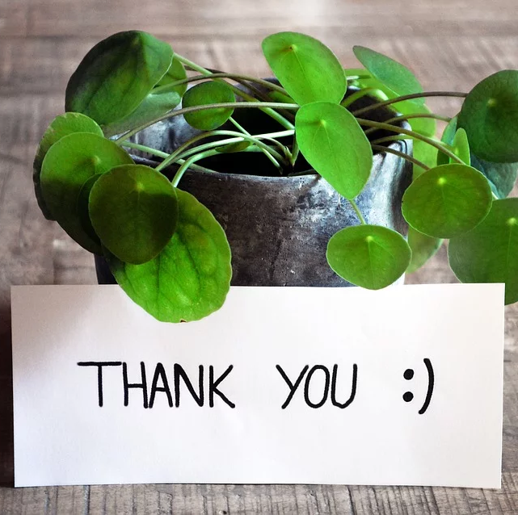
In appreciation
The following slides are taken from the materials shared on https://www.liberatingstructures.com/13-wise-crowds/

Slide 3
An Overview of the session
What does Wise Crowds Help us achieve?
Minimum Specifications (Min Specs) For facilitating Wise Crowds
A chance to practice
Tips and Traps

Slide 4
Moment to pause

Slide 5
What does Wise Crowds Help us Achieve
It encourages us to ask for help by taking a turn of being the client. It also helps build trust
It supports self correction and understanding
It taps into the creativity and inventiveness of everyone in the group who take on the role of consultants
Participants benefit from being the client and the consultant
‘’ Wise Crowds consultations make it easy to achieve transparency. Together, a group can outperform the expert!’’

Slide 6
Min Specs for Facilitating Wise Crowds
Structuring invitation
In turn people are asked to be a client sharing their challenge and the rest of the group consultants to help the client clarify their challenge and offer something helpful
How space is arranged and materials needed
Groups of 4 or 5 chairs arranged around small tables or in circles without tables
Paper for participants to take notes
A watch to keep time

Slide 7
Min Specs for Facilitating Wise Crowds
How participation is distributed
Everyone is included and has an equal opportunity and time to ask for, receive help and everyone has a chance to offer help
How groups are configured
Groups of 4 to 5 people
Mixed groups across functions, levels, and disciplines are ideal
The person asking for help, the “client,” turns their back on the consultants after the consultation question has been clarified

Slide 8
Sequence of steps and time allocation
Each person requesting a consult (the client) gets fifteen minutes
broken down as follows:
The client presents the challenge and request for help. 2 min.
The consultants ask the client clarifying questions. 3 min.
The client turns his or her back to the consultants and gets ready to take notes
The consultants ask questions and offer advice, and recommendations, working as a team, while the client has his or her back turned. 8 min.
The client provides feedback to the consultants: what was useful and what he or she takes away. 2 min.

Slide 9
Tips and Traps
Invite a very diverse crowd to help (not only the experts and leaders)
Invite participants to critique themselves when they fall into traps (e.g., jumping to action before clarifying the purpose or the problem). See Helping Heuristics for a complete list of unwanted patterns when helping or asking for help.
Remind participants to try to stay focused on the client’s direct experience by asking, “What is happening here? How are you experiencing what is happening?”
Advise the consultants to take risks while maintaining empathy
Avoid having some participants choosing not to be clients: everybody has at least one challenge!
If the first round is weak, try a second round
Invite participants not to shy away from presenting complex challenges without easy answers
Link to and string with Helping Heuristics plus Heard, Seen, Respected (HSR), Nine Whys, Troika Consulting, What I Need From You, and Appreciative Interviews. These Liberating Structures offer a variety of productive choices for helping.

Slide 10
An opportunity to practice
Each person requesting a consult (the client) gets fifteen minutes broken down as follows:
The client presents the challenge and request for help. 2 min.
The consultants ask the client clarifying questions. 3 min.
The client turns his or her back to the consultants and gets ready to take notes
The consultants ask questions and offer advice, and recommendations, working as a team, while the client has his or her back turned. 8 min.
The client provides feedback to the consultants: what was useful and what he or she takes away. 2 min.

Slide 11
Further Information
For further information on Liberating Structures Please visit https://www.liberatingstructures.com/
Presented by Hilda Campbell to The Q Community LS SIG Convenor Nurturing and Weaving Networks SIG and Staff Wellbeing SIG
For further information on the Nurturing and Weaving Networks SIG and Staff Wellbeing SIG please email hilda@cope-scotland.org www.cope-scotland.org @COPEScotland

