Slide 1
Personal wellbeing Self care is not self indulgence, it can be self preservation
This presentation is not a replacement for professional advice

Slide 2
A moment to pause

Slide 3
Because you matter too
Why do so often do we put the needs of others before our own?
Why does compassion for others often make us forget to be compassionate to ourselves?
We are not immune to the very challenges we are supporting others overcome/adapt to
Learning to give ourselves permission to look after us too is necessary as we cannot help others when we ourselves are on our knees

Slide 4
The Thousand Yard Stare
‘’The thousand-yard stare or two-thousand-yard stare is a phrase often used to describe the blank, unfocused gaze of combatants who have become emotionally detached from the horrors around them. It is also sometimes used more generally to describe the look of dissociation among victims of other types of trauma.’’
en.wikipedia.org/wiki

Slide 5
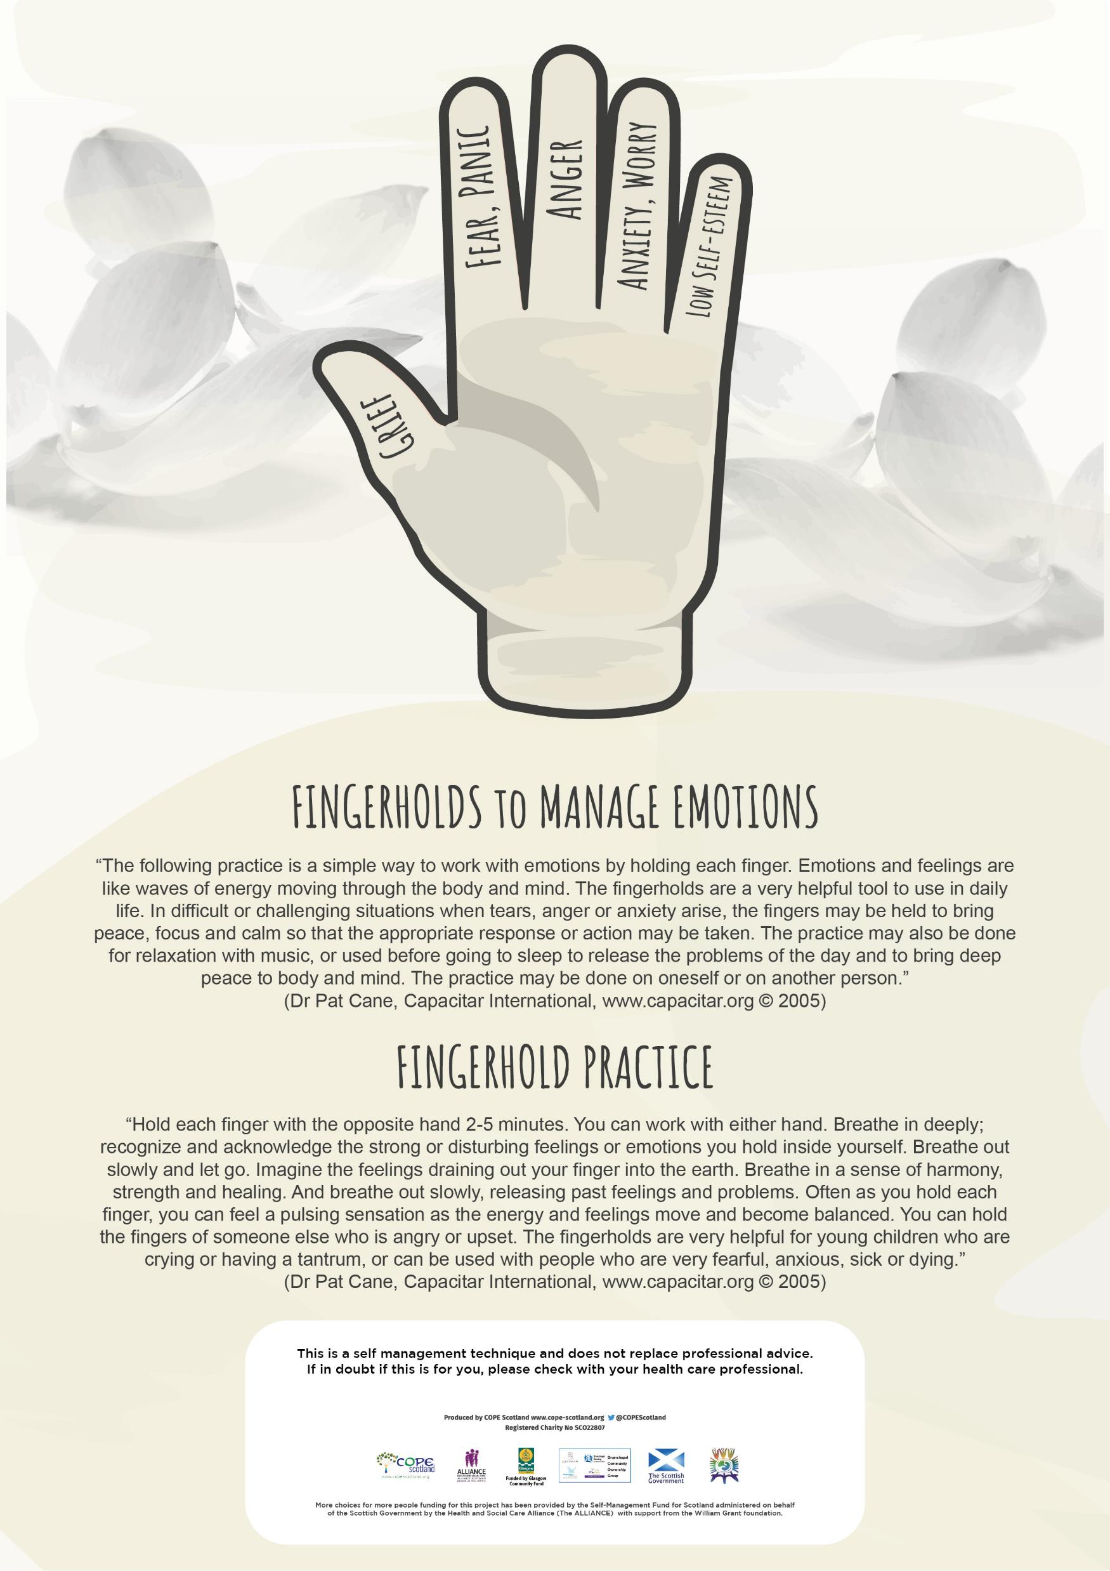
Fingerholds for managing challenging emotions
https://capacitar.org/
https://www.cope-scotland.org/wellbeing-tips/entry/surviving-until-we-can-move-back-to-thriving

Slide 6
Challenge the myth Self care is self indulgent

Slide 7
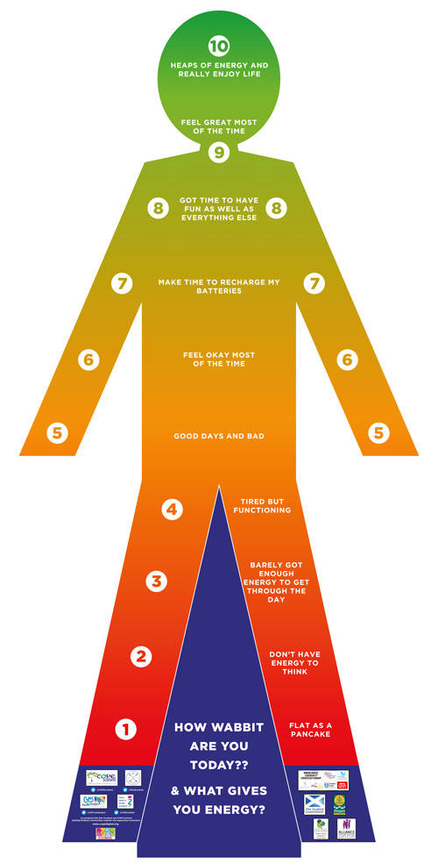
Learn to check in with how you are doing

Slide 8
We are all unique Find the pieces of the puzzle which works for you, and you want to do it!
https://www.cope-scotland.org/wellbeing-tips/entry/identifying-the-pieces-which-support-your-well-being-jigsaw-lid

Slide 9
Even a few moments can make a difference www.cope-scotland.org/wellbeing-tips/entry/learning-to-hit-the-pause-button

Slide 10
Invitation to act
Here are three invitations which you may find of value and want to accept
Find a way to check in and assess your own wellbeing that works for you
If finding out more ways to look after you is of interest, consider completing your own Jigsaw lid of the pieces for your wellbeing and consider plans to bring them into your life
Give yourself permission to find self care actions which work for you and bring them into your day everyday
It really matters that ‘self care’ doesn’t feel like something else you ‘need to do’. It should be something you look forward to and find of value. Sometimes we don’t know what works for us until we give it a try. We may not like it first time so give it another go, if we really find it unhelpful, explore other options, there will be healthy self care practices you do enjoy, its giving yourself permission to look for them
Thank you
For more information
hilda:@cope-scotland.org
www.cope-scotland.org
@COPEScotland

