Slide 1

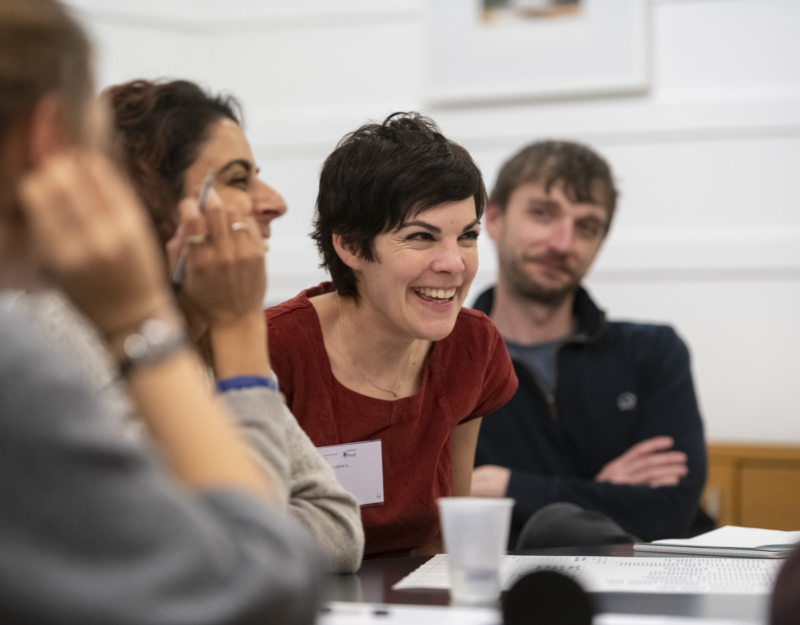
‘Safety-II: A Critical Look at the Promise and Potential for Healthcare’
With Simon Gill, Mark Sujan and Jonathan O’Reilly.
** STARTS 12.30PM **
Welcome: please introduce yourselves in the chat room:
  Your name
  Where you are from
  Why you are here today, what you want to get out of the webinar or what question you have for the hosts
  NB Please remain on mute unless you need to speak – to reduce background noise

Slide 2
Agenda
Conveners Welcome Simon Gill
The Promise and Potential of Safety-II Mark Sujan
Safety-II Stories from the Community
  Falls QI, Bianca Viegas, East and North Hertfordshire NHS Trust
  Learning from Excellence, Prof Rob Cunney, Childrens Health Ireland
Your Answer and Your Reflections
Close Simon Gill

Slide 3
Conveners Welcome
Simon Gill

Slide 4
The Promise and Potential of Safety-II
Mark Sujan

Slide 5
Safety-II Stories from the Community
Falls QI, Bianca Viegas, East and North Hertfordshire NHS Trust
Learning from Excellence, Prof Rob Cunney, Childrens Health Ireland

Slide 6
Your Answers

Slide 7
How would you describe your organisation’s implementation of Safety-II principles?

Slide 8
What kind of problems/issues have you applied Safety-II to?
I am interested in understanding more about Work as Done and particularly what healthcare leaders need to do in order to lead.
Central line associated bloodstream infection
Anaesthesia safety
Medication Delivery
Lack of it’s even existence and being entrenched in safety I
Safeguarding adult reviews
SAE analysis, quality planning within healthcare pathways.
deteriorating patient
Low and no harms data
Cancer pathway design
Everyday work in acute healthcare settings
observing systems within theatres and ED
Haven't applied it personally but there is a LFE initiative in hospital
Never Event Improvement work
i include it in my Appreciative Inquiry training as it fits so well with that philosophy, and i mostly train NHS staff
During clinical incident reviews.
The diagnostic process
Insight and proactive work
Air traffic management
clinical processes
Small steps
Incident analysis
Clinical areas which high incident rates
Learning from excellence / WAI v WAD
Currently looking at how to bring Safety-II principles in at a national level through our upcoming National Policy (Wales)

Slide 9
What kind of interventions did you develop using Safety-II principles?
None - I just try to teach the theory.
Appreciative Enquiry X 2
Improved labels / icons.
Falls QI work- understanding what patients don’t fall from what works well
safety huddle
Using data
An improvement plan
QI project list
System review of Orthopaedic Speciality
Pre-announcement
Service improvement
Various
Onboarding training mostly to date
Learning From Excellence X 3
Noted practice in an incident

Slide 10
How did you evaluate these interventions?
Prospective audit
Experimentally and use
Never got that far
safety culture, adverse events
Still scoping and unsure
Was not involved
Not evaluated
QI projects
None as yet as not in use within the organisation yet
My Msc dissertation was on concepts of Safety II and its use in Obstetrics
satisfaction / to follow
Too early to know
Didn’t follow through with evaluation

Slide 11
What barriers/challenges have you encountered, and what kind of successes?
Safety-I thinking proliferates…
Fixation with "error" and "standardization" of behavior.
Frontline not familiar with S II concepts; Safety I gets priority;
It’s really hard to do safetyII in QI where it’s usually focused on a problem. Also safetyI approach prioritised by Trust
Not yet a clear understanding of Safety II
Poor understanding in nursing and midwifery of safety II

Slide 12
What barriers/challenges have you encountered…?
Adverse Culture:
culture! Leadership
Resistance to change, not sufficiently evolved safety culture
Changing established thinking and the NHS not having safety 2 embedded as an approach
Culture
Lack of Resources:
lack of resources.
limited resource to do.
available time of clinicians
Lack of capacity:
Staff fatigue and multiple priorities
Lack of Engagement:
Engagement from stakeholders
Measurement Challenge:
difficult to measure besides satisfaction
Non events are difficult to evaluate

Slide 13
…What kind of successes?
Local success at ward level.
None as yet as not in use within the organisation yet

Slide 14
Your Reflections

Slide 15

Next Steps
https://q.health.org.uk/community/groups/organisational-resilience/

