Slide 1
How charged is your personal battery right now?
COPE Scotland www.cope-scotland.org @COPEScotland

Slide 2
Take a moment to recharge

Slide 3
Session Overview
How are your energy levels right now
Where do you spend your energy and can changes be made
How do you top your energy back up, and can changes be made
Tips for having more energy
A personal promise card

Slide 4
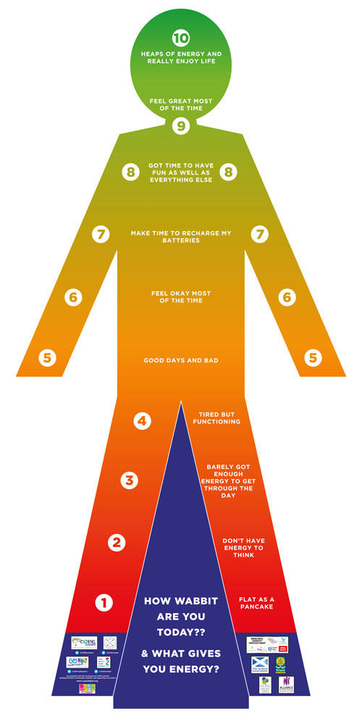
The battery dude

Slide 6
Recharging your batteries

Slide 7
Boundaries
Notes:
Boundaries

Slide 8
It is not selfish to put your own oxygen mask on first

Slide 9
A personal promise

Slide 10
Discussion
How useful do you think these resources may be in your workplace, with your teams?
Take some time to share other ideas and resources you know of which can help support staff wellbeing

Slide 11
Thank you
For more information email hilda@cope-scotland.org @COPEScotland

