Slide 1
Managing ethical complexity in healthcare improvement

Slide 2
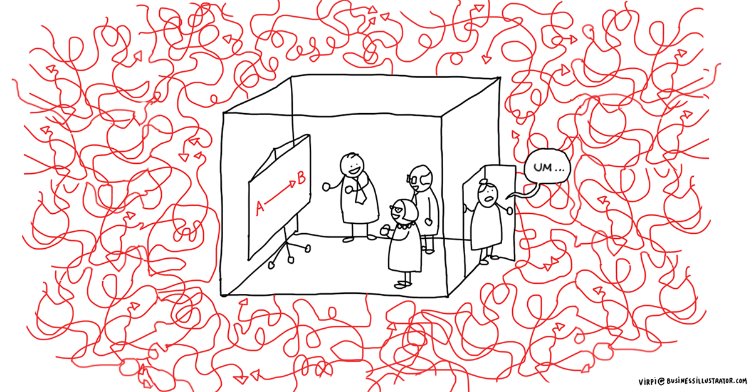
Causal complexity
Healthcare systems are causally complex
Adaptable elements
Non-linear
Subject to ‘external’ factors
Notes:
It can be difficult to know precisely what causes what. In the context of improvement, this means that it can be difficult to say with certainty what effects an improvement intervention will have and has had—that is, whether an improvement has worked.
E.g.:
Adaptable elements: In human systems, people adapt to changes in policy in practice, and can change their behaviour in unexpected ways in response to improvement interventions
Causes and effects can be non-linear: small changes can have big effects (e.g. a rumour leading to widespread behaviour change) and big changes can have limited effects (e.g. large scale restructuring of management having limited effects on practices and outcomes)
Subject to external shocks: social, political, pathological factors can change what happens in healthcare institutions.
Often cause and effect in healthcare is not predictable in detail: while it may be possible to model general trends, it can be almost impossible to forecast about the detail, particularly over longer timescales.

Slide 3
Ethical complexity
Healthcare systems are also ethically complex
Mixed outcomes
Lost opportunities
Disagreement
Notes:
It can be difficult to know what is ‘good’ or ‘better.’ In relation to improvement, it can be hard to say whether a change is an improvement—whether a health service is better with or because of the change.
E.g.
Mixed outcomes: The change makes things better in some respects and worse in others
Lost opportunities: The change took resources away from other projects which would have been better
Disagreement: Some people think it’s better and others disagree. There is disagreement about what matters and how much it matters.
These issues mean that claims that some change amounts to an improvement are contested and not entirely straightforward

Slide 4
Measurement
Measurement is crucial for causal and ethical claims about healthcare improvement
What has changed?
How good/bad is it?
How does this compare to other times/places?
Notes:
Measurement is crucial for both the causal and ethical claims about healthcare improvement by:
Helping to justify claims about the effects or predicted effects of changes
Helping to justify claims about how good/bad healthcare is
Supporting comparisons across time and settings

Slide 5
Measurement is not a silver bullet…
For causal claims about improvement
Or ethical claims about improvement
Measures can miss out important aspects of healthcare
Perverse incentives and side effects
Priorities and deciding what matters
Disagreement
Costs of measurement
Notes:
On the causal side, measurement doesn’t necessarily resolve claims about whether an improvement has worked:
Can miss important aspects of healthcare which are difficult to define and measure
Can create perverse incentives and side effects (when measures become targets, they often incentivise people to ‘game’ the system by ‘hitting the target and missing the point’ or reducing performance where targets do not apply
On the ethical side, measurement doesn’t resolve questions about what is good or better
Priorities: Even if we can be pretty sure about the effects of an intervention, in order to know whether they make things better or not we would need to judge the importance and priority of those effects.
Disagreement: There can remain disagreement—intractable disagreement—about what the relative priorities are, how significant different costs and benefits are, and what else could or should be done with the resources
Measurement and improvement has costs (e.g. the costs of setting up and operating measurement systems and the time taken away from other activities)

Slide 6
Conversations
Conversations can help to manage ethical complexity
Open-ended, respectful interactions
Different voices and viewpoints
Explore points of tension and difference
Don’t necessarily resolve them
Develop mutual understanding
Notes:
Different ways of managing normative complexity and the limitations of measurement as a decision-making tool.
One is conversations.
Open-ended, respectful interactions between different people which
Allow for consideration of different voices and viewpoints
Enable points of tension and difference to be identified and explored
Do not necessarily involve resolution or finding answers
But can enable people to understand one another and change their perspectives
Can be more formal and structured—e.g. pre-scheduled time for discussion, on set topics, arranged by institution—or less formal and unstructured—conversations between colleagues, or between patients and staff, e.g. about what is working and what is not working

Slide 7
Conversations and healthcare improvement
Conversations can contribute to ethical healthcare improvement decision-making
Explore different things that matter, to different people, in healthcare
Interpret and critique measures and measurement approaches
Think about what could go wrong
E.g. Experience-based co-design
Notes:
Conversations can feed into ethical healthcare improvement decision-making
Explore the variety of things that matter, to different people in order to think about what a ‘better’ healthcare service would look like
Create spaces to interpret and critique measures and measurement approaches
And to think about what could go wrong as well as focussing on how interventions could make things better
E.g. Experience-based co-design: conversations that ‘bring together’ the experiences and voices of staff, patients and carers to think about how services could be better. Carefully orchestrated process with the specific aim of informing service re-design and improvement.

Slide 8
Conversations after improvement
Conversations allow reflection on ethical issues—even once decisions have been made
In practice, decisions have to be made to pursue improvement projects or not
Some issues only arise after decisions are made
Conversations keep alive the tensions and challenges
E.g. Schwartz rounds
Inform future decision-making
Notes:
Conversations can continue and continue to be valuable after improvement projects have been completed or decisions made about future action.
In practice, decisions have to be made to pursue improvement projects or not
Some issues only arise after decisions are made, so there needs to be space to keep talking about the effects of interventions
But conversations can keep alive the disagreements and tensions that may underlie such decisions (e.g. the costs involved, the things unmeasured and left out, the people who are not served)
E.g. Schwartz rounds: regular forums to which all members of staff (clinical and non-clinical) within a healthcare institution are invited in order to reflect on and discuss social, emotional and ethical challenges. Facilitated but not structured around a particular agenda. Open-ended.
Not just about airing grievances, but can also inform future decision-making.

