Slide 1
Jigsaw lids toolkit
A simple resource to help share perspectives of diverse stakeholders

Slide 2
An overview of the session
What is the Jigsaw lid toolkit?
How the Jigsaw lid toolkit was used in primary care transformation
The opportunity to explore with peers creating a lid of conditions which support effective networks

Slide 3
Time to pause

Slide 4
Why did we need the Jigsaw Lid Toolkit
Systems are complicated and complex
People are complicated and complex
Environmental issues are complicated and complex
Economic issues are complicated and complex
……..
Yet we expect simple answers and imagine we can find some way we all agree on what those answers will be!

Slide 5
Different perspectives common priorities

Slide 6
The Jigsaw toolkit and primary care
The Jigsaw Project was a GP-cluster led partnership initiative to co-design new pathways of intervention in mental health.
Its aim is to support the health and wellbeing of people and families in Drumchapel and Yoker by improving connections between primary care, mental health services and community assets, and to share the learning across Scotland and beyond.
It was a partnership between the Drumchapel and Yoker GP Cluster and their project partners COPE Scotland and Drumchapel Life, and is supported by NHS Greater Glasgow and Clyde with funds provided by the Scottish Government’s Transforming Primary Care Mental Health Initiative

Slide 7
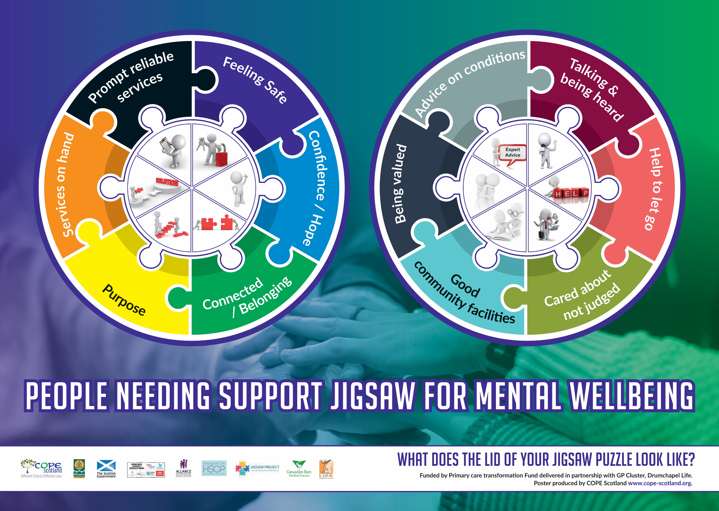
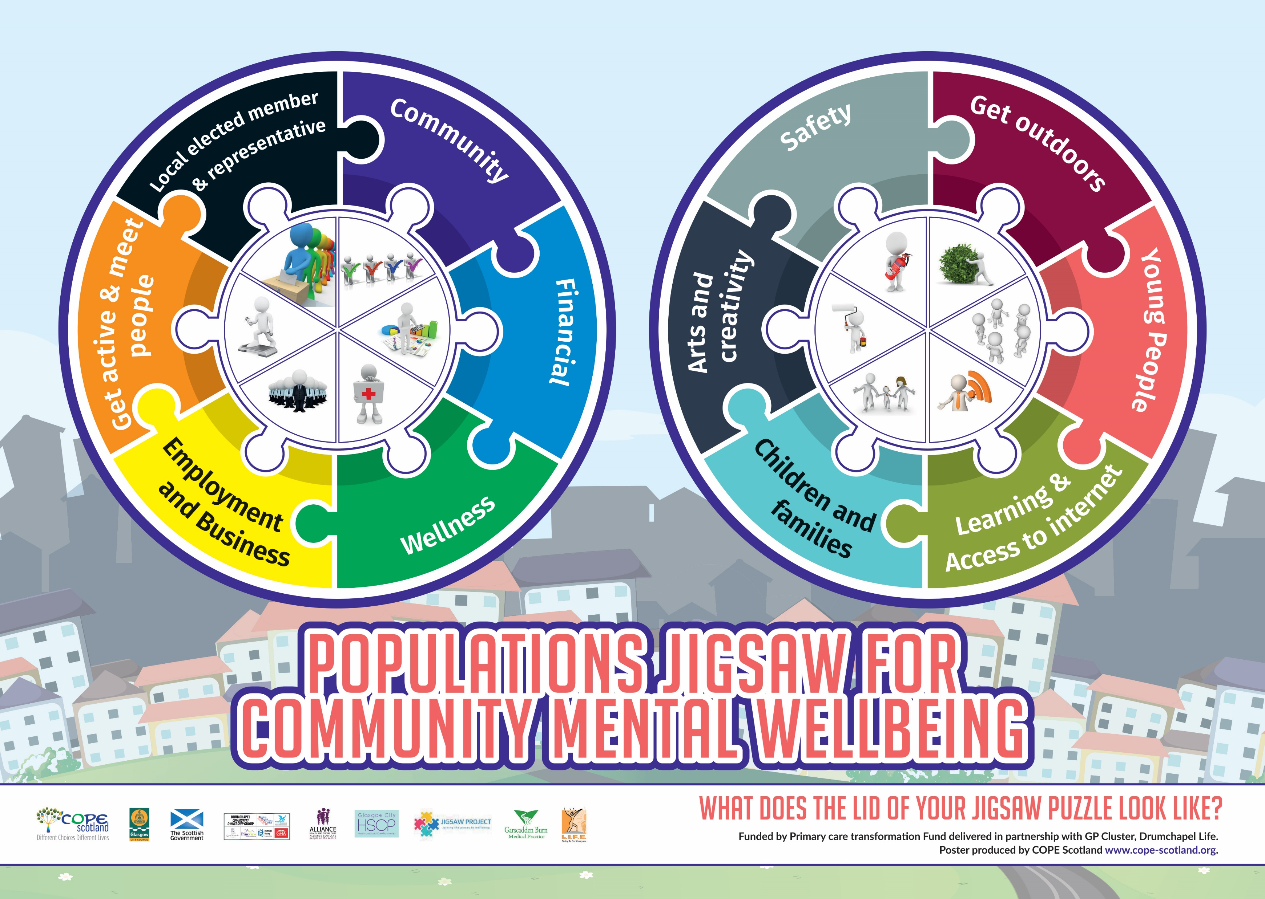
The Jigsaw Lids created for the Jigsaw Project

Slide 8
The Impact of the Jigsaw Project 2017-2019
People have an improved experience of integration of primary and community-based services
Reduction in appointments as individuals are making more use of community- based services
There is a new understanding and experience of Shared Decision making
GP’s have a new model of working
Community resources notice an increased uptake of what they offer
The Community has more confidence to explore and establish their own self-reliant groups
There is more confidence in the use of participatory budgeting
There are new relationships between primary care and the third sector and new opportunities to explore joint funding bids

Slide 9
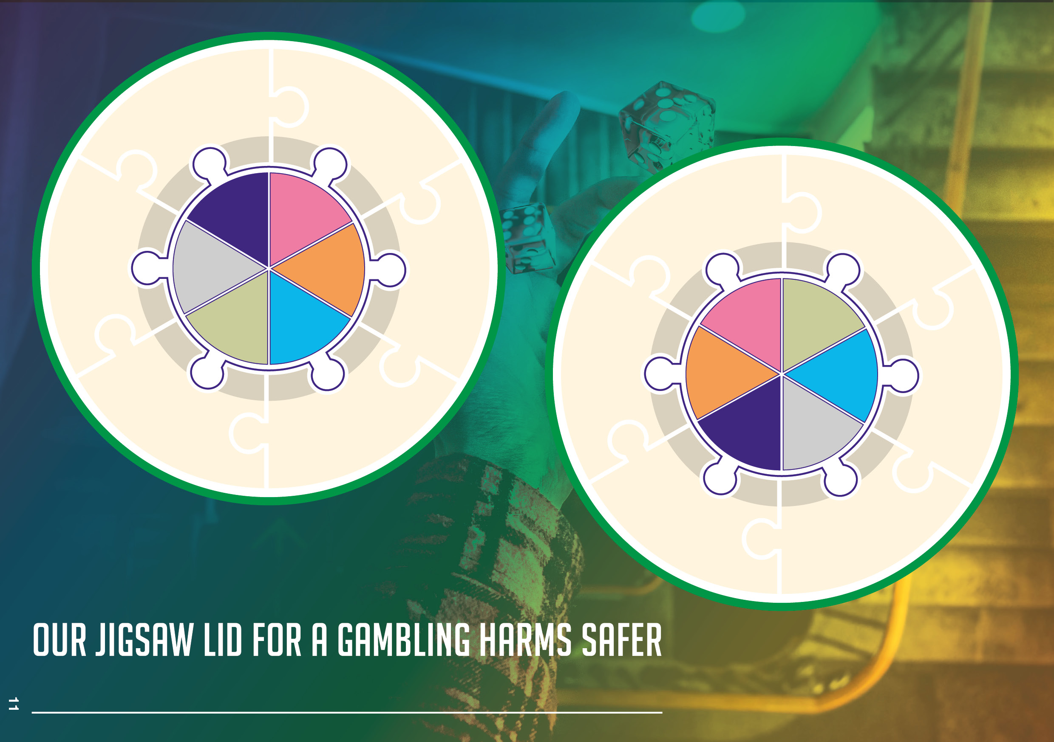
The Jigsaw toolkit continues to evolve

Slide 11
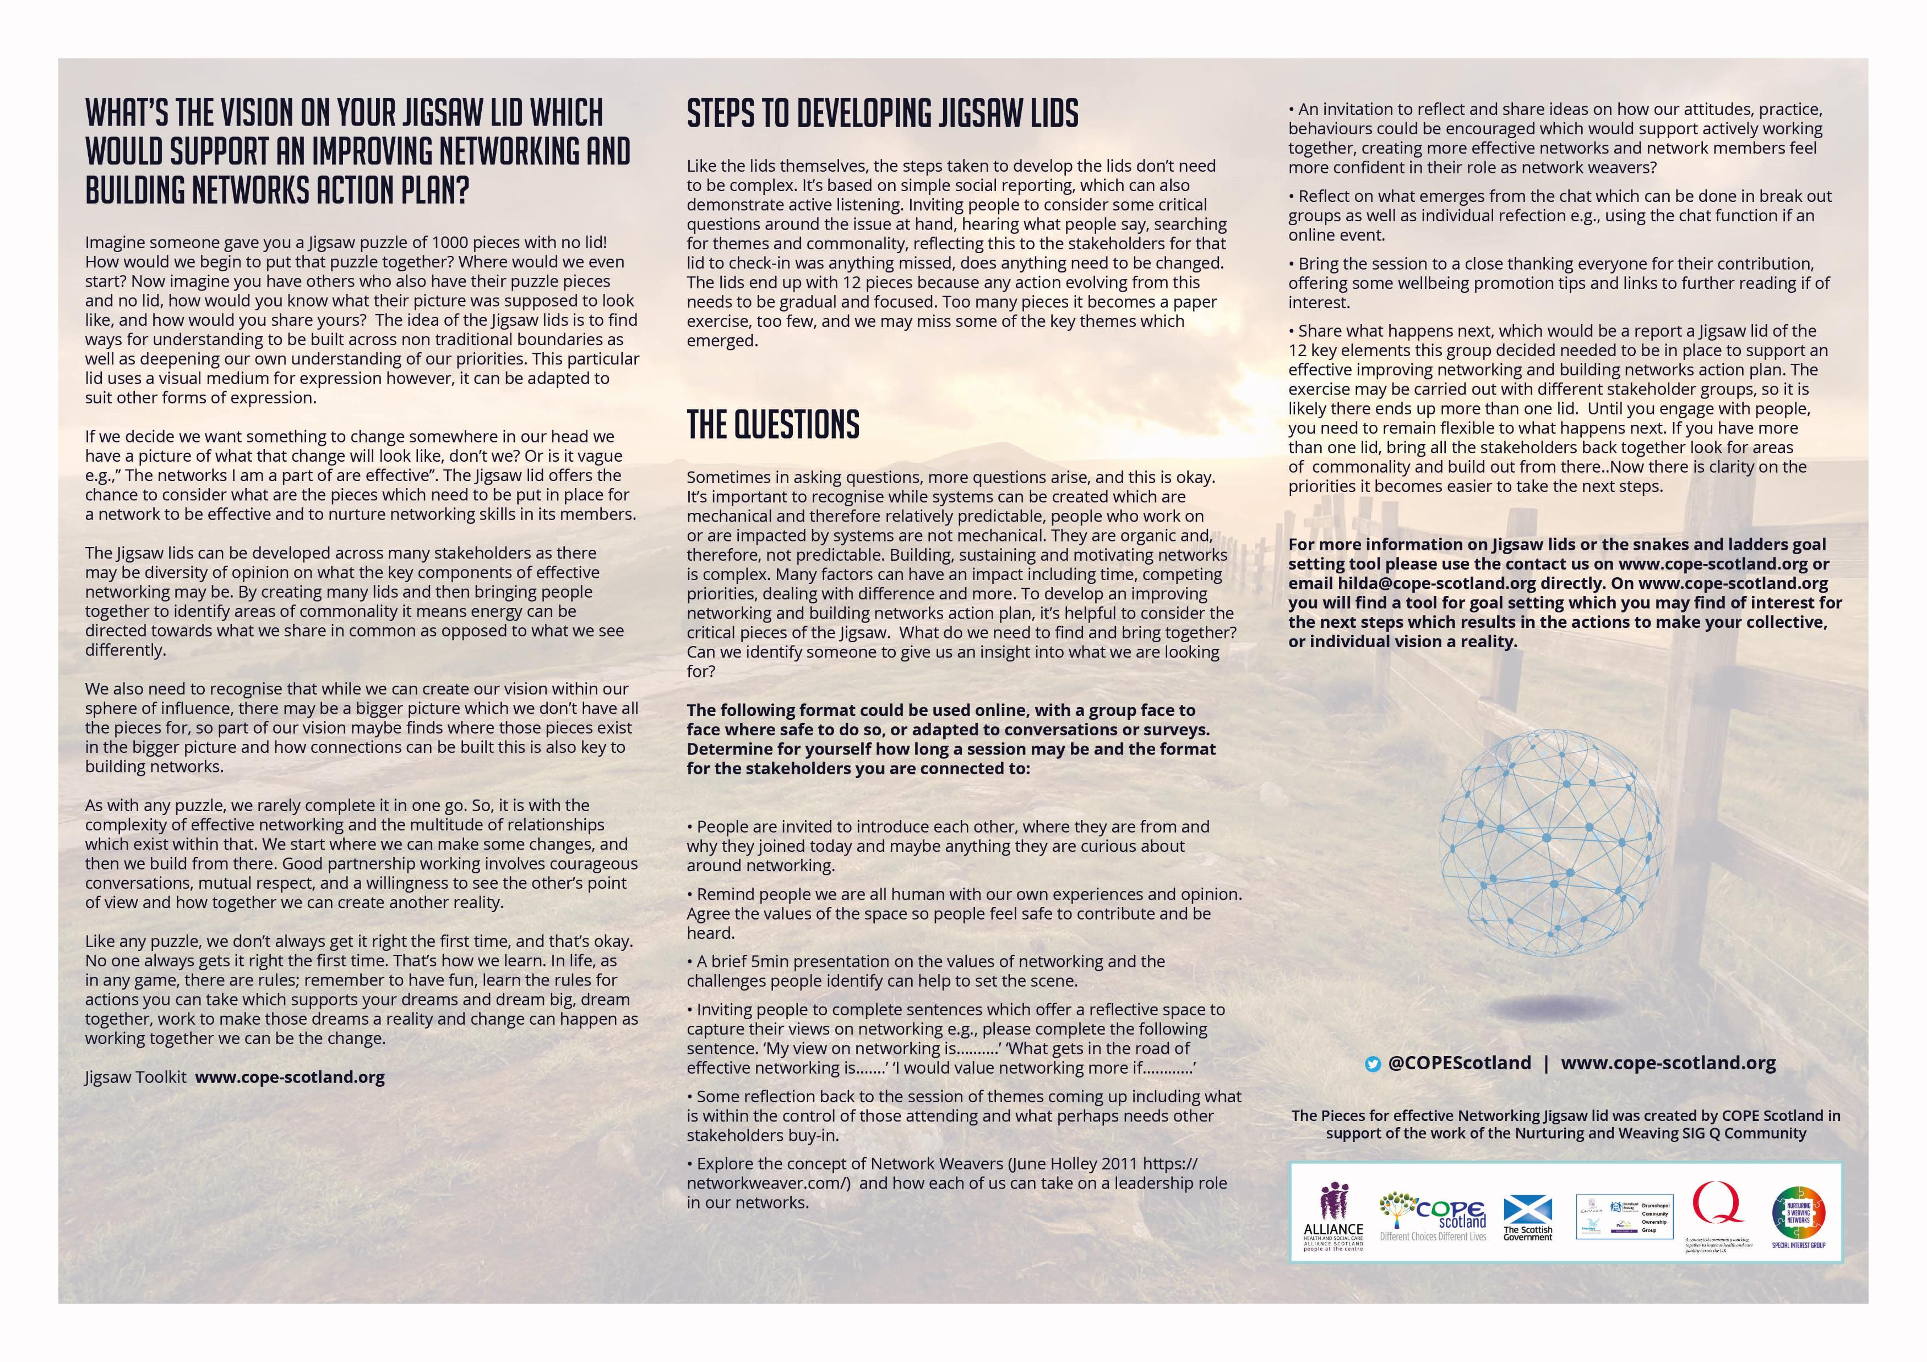

Slide 12
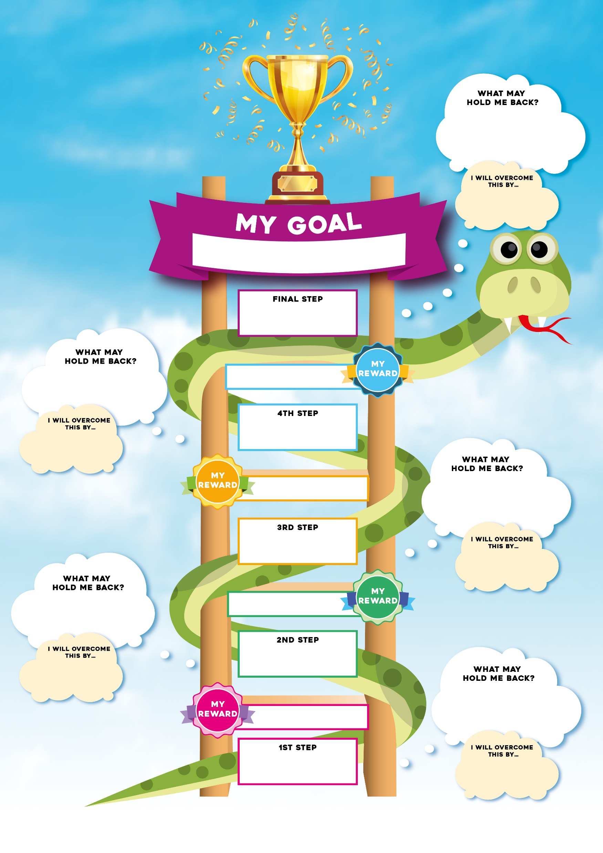
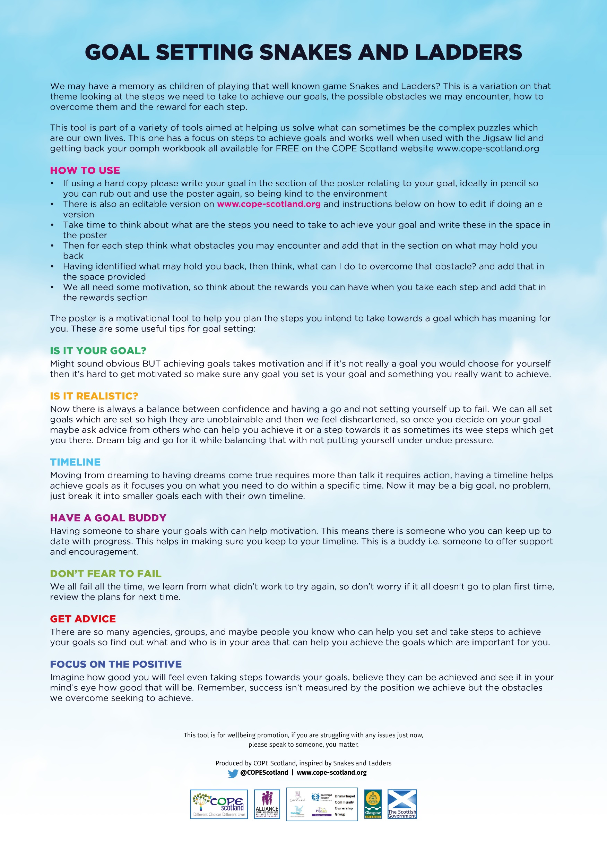
Goal setting snakes and ladders

Slide 13
Time to practice
In the chat please complete the following sentences
My view of networking is………
What gets in the road of effective networking ……..
I would value networking more if…………….

Slide 14
Time to practice in groups
Introduce yourselves to each other 2min
Discuss the key elements you think support effective networks 10min
Agree on 12 key elements which you think would make the most impact 10min (which we invite you to share in the chat box when you return to the main group please)
Discuss if you think this approach would have value in your setting and why 5min

Slide 15
Reflections

Slide 16
Three invitations
Consider if using the Jigsaw toolkit for developing network learning may be helpful for you/your group or organisations needs
Secure a copy of the Jigsaw lid in the download section on Nurturing and Weaving Networks SIG
Identify the diverse stakeholders whose views you want to capture and set up times to chat, create lids for each group and then decide on areas of commonality and what next
For more information visit www.cope-scotland.org or email admin@cope-scotland.org

