Slide 1
Staff wellbeing Special Interest Group The Q Community Staff wellbeing SIG
Ideas to help each other find more time
15sec30min

Slide 2
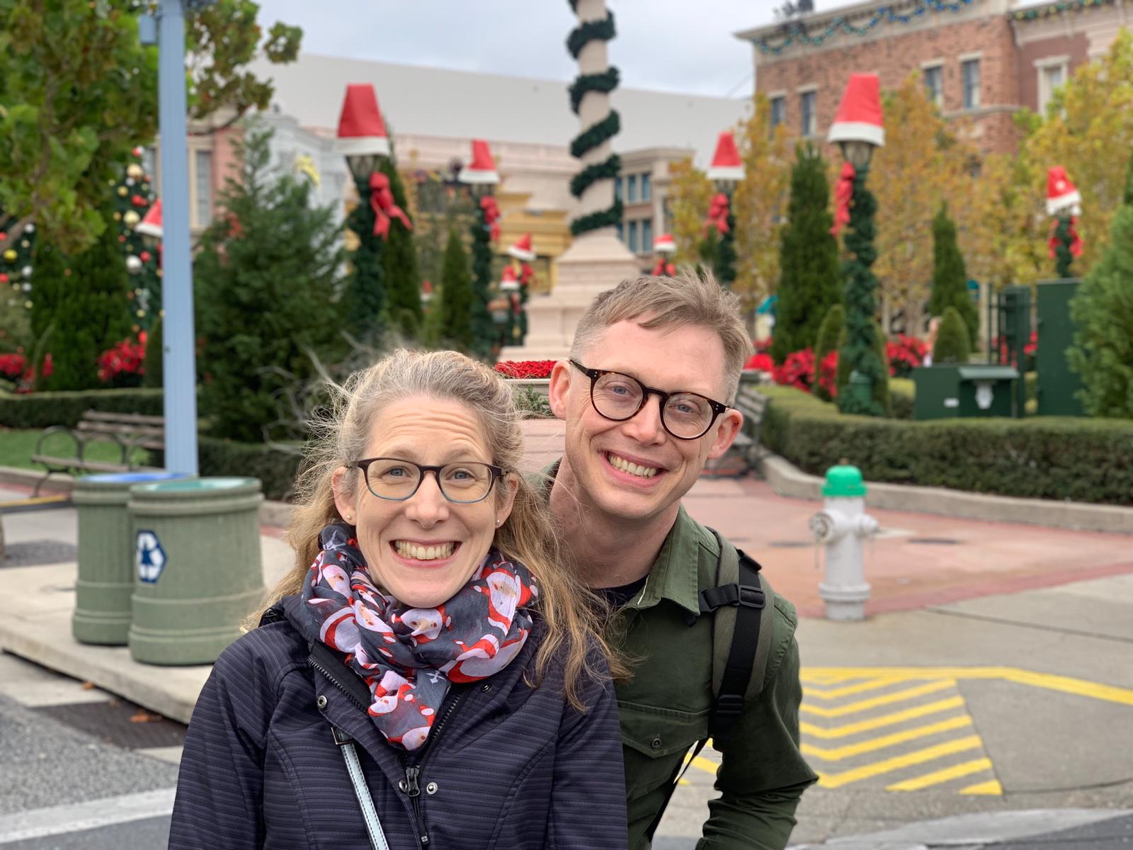
In gratitude to the founders of 15sec30min
Rachel Pilling
Consultant Ophthalmologist
@miss_pilling
(co-founder of 15s30m)
Dan Wadsworth Transformation Manager @Danwod
(co-founder of 15s30m)
info@15s30m.co.uk @15s30m
#15s30mMission

Slide 3
Improving Joy in work Special Interest Group
Joy in work SIG

Slide 4
Overview of the session
Why finding time is a challenge
How 15sec30min can help
Where to get more information on 15sec30min
Discuss in small groups your view of this approach

Slide 5
Time to pause

Slide 6
Why do you think finding time can be a challenge?
Please take a moment if you feel safe to do so to complete the following sentences in the chat box
Time can be a challenge because…….
What helps my time management ……….

Slide 7
Liberating structures Min Specs
What is made possible? By specifying only the minimum number of simple rules, the Min Specs that must ABSOLUTELY be respected, you can unleash a group to innovate freely.
Respecting the Min Specs will ensure that innovations will be both purposeful and responsible. Like the Ten Commandments, Min Specs are enabling constraints: they detail only must dos and must not dos. You will eliminate the clutter of nonessential rules, the Max Specs that get in the way of innovation.
Often two to five Min Specs are sufficient to boost performance by adding more freedom AND more responsibility to the group’s understanding of what it must do to make progress. Out of their experience in the field, participants shape and adapt Min Specs together, working as one. Following the rules makes it possible for the group to go wild!
Min Specs
Liberating structures user group

Slide 8
What is 15sec30min
Intro 15sec30min Video

Slide 9
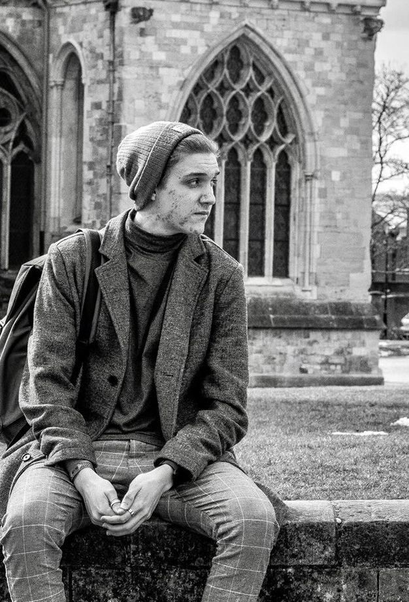
15sec30min in action
Meet Owen
Studying medical imaging (diagnostic radiography) at Exeter University, Devon
Owen’s 15 second mission is raising awareness about ‘invisible’ conditions, sometimes assumptions take control when the other person has got a lot going on ‘behind the scenes’
(15sec30min hero featured on 15sec30min website)

Slide 11
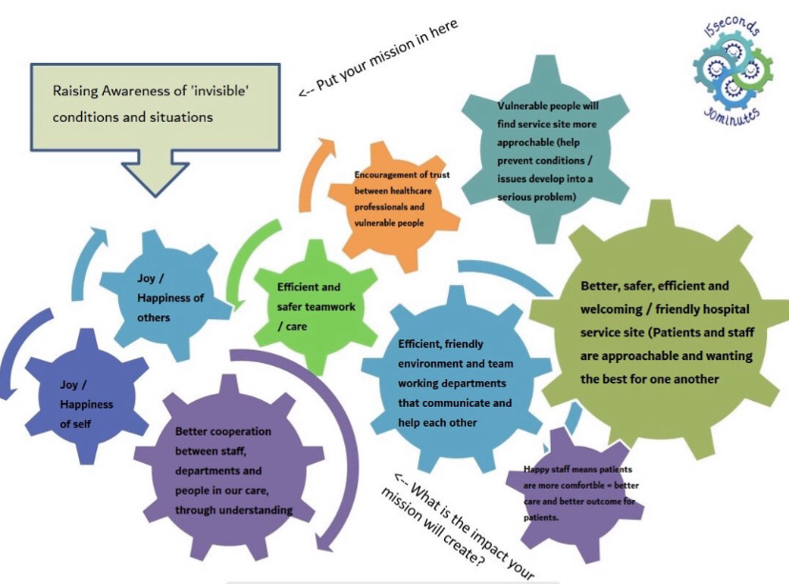

Slide 12
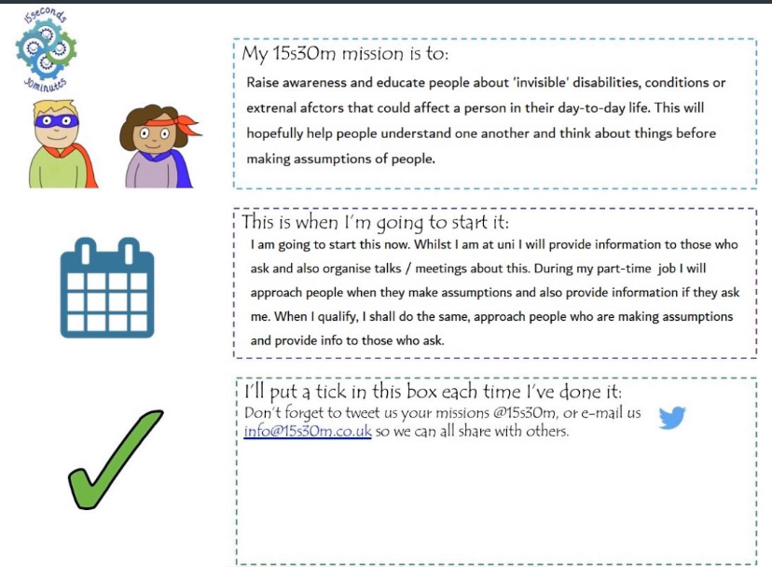

Slide 13
Where to access more information on 15sec30min Mission Pack
How to run a workshop
Videos to use in the workshop
Workshop agenda
Workshop questionnaire
Workshop PowerPoint
What matters to me workbook
Workshop mission pack
FAQ

Slide 14
Time to explore further The aim of this session is to invite curiosity around 15sec30min in order that people decide for themselves to visit the site to find out more and consider running a workshop with their own teams. However, we also wanted to provide space to explore the Mission pack
In groups
Introduce yourselves 2min
Discuss among yourselves things you find frustration and agree on one of these frustrations 6min
Discuss among yourselves the frustration you agreed to focus on and what could increase joy and agree on one action which is your mission 6min
Reflect on the impact your mission will make 6min
Reflect if you intend to put this mission into practice and when 5min

Slide 15
My 15s30m Mission Pack
Its frustrating when…..
I can increase Joy by…..

Slide 16
<-- Put your mission in here
<-- What is the impact your mission will create?

Slide 17
My 15s30m mission is to:
This is when I’m going to start it:
I’ll put a tick in this box each time I’ve done it:
Don’t forget to tweet us your missions @15s30m, or e-mail us info@15s30m.co.uk so we can all share with others.

Slide 18
Time to reflect
Please share your view in the chat box by completing the following sentence
On a scale of 1-10 where 1 is I will not and 10 is I definitely will how likely are you to share this approach with your team………
On a scale of 1-10 where 1 is there is no value to this approach and 10 is there is definitely a value in visiting the 15sec30min website and learning more
What I took away from today was…………
What I want to know more about is……………

Slide 19
Become a 15sec30min hero
What’s a 15s30m hero?
15s30m heroes are people who have launched their own 15s30m mission and it has spread to other people so they are also running missions to help reduce frustration and increase joy.
Want to feature in the 15s30m Hero Hall of Fame below?
Heroes will receive a little cog to go on their ID badge or keyring and a badge so you can spot other heroes hiding in your organisation.
Just fill in the 15s30m-Hero-questions, email your answers and a picture of yourself along with a postal address for your cog to info@15s30m.co.uk and you’ll be uploaded so others can also get joy in work from your mission, and be inspired to launch their own missions!

