Slide 1
Q LS User Group-
virtual meetup #13
Taking LS further
‘Planning for your Own Challenge’
Notes:
Joriam finalize slide and facilitate
Link to session app - https://app.sessionlab.com/sessions/yiNLei

Slide 2
Welcome
Introductions
Meetup principles
Feedback
Notes:
Joriam finish and faciltate

Slide 3
Meet-up purpose
To trial structures
To share approaches to virtual workshops
To develop a network of Q LS folk
Notes:
Joriam to finish and facilitate

Slide 4
What are Liberating Structures?
Simple social workshop designs that distribute participation more widely, while drawing out greater difference and variation within groups
A repertoire of techniques that reliably generate novelty
A collection for organising groups to collaborate and mutually shape their work together
Tools & facilitation techniques that share a similar logic or organising structure
Tiny methods that make it possible to benefit from complexity instead of flattening, ignoring, and pushing it away
Notes:
Joriam finish

Slide 5
The workshop exists to….
provide a space for people who have been using LS for some time/are familiar with structures to take their practice further
think about strings of structures
enable colleagues to plan for their own challenge
give and get help from others
be a safe space to practice
this workshop in two parts - but you will get the best out of it if you stay for it all
Notes:
? Joriam finish and cover

Slide 6
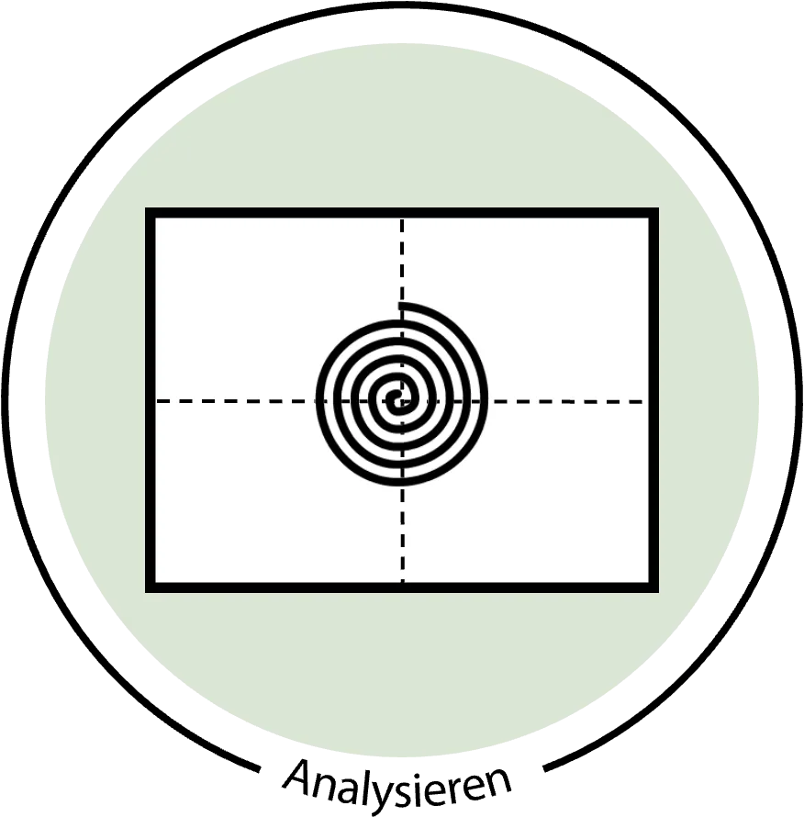
Today’s String
Check in (taste of ecocycle)
Impromptu networking
P2P (taste of)
Matchmaker tool (taste of design storyboards)
Troika Consulting
Spiral Journal
Notes:
Joriam finish slide and facilitate

Slide 7
Notes:
Joriam finish and introduce and set up jam board

Slide 8
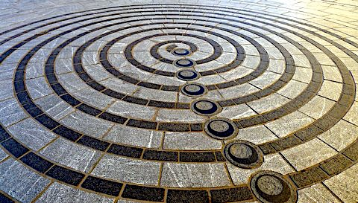
Impromptu Networking Rapidly share challenges and expectations while building new connections
Notes:
Kristin to invite people to take 30 sec to think about specific prompt, what is upcoming situation or meeting that you have the responsibility to facilitate or lead where you could using a string of LS? what is the purpose of that event?; introduce LS

Slide 9
Impromptu networking (15 mins)
Three rounds of 3-4 mins, in pairs
One minute to gather your thoughts…
Introduce yourselves and share:
what is upcoming situation or meeting that you have the responsibility to facilitate or lead where you could using a string of LS? what is the purpose of that event?
Notes:
Kristin to finish and facilitate

Slide 10
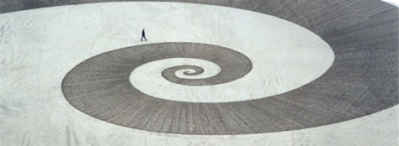
Purpose-to-Practice Design the Five Essential Elements for a Resilient and Enduring Initiative

Slide 13
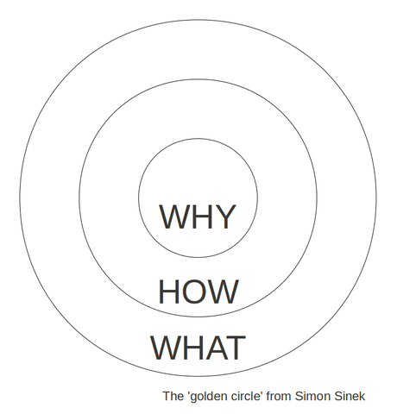
Purpose
What is the purpose of the session?
What would be the ideal outcome?
What do I want to make possible?
This meeting/workshop/event exists to…..

Slide 15
Participants
Participants:
Who should contribute to this session?
Who must definitely be included to achieve the purpose?
Who could support me in co-facilitating the session?

Slide 16
So far
Check in (taste of ecocycle)
Impromptu networking
P2P (taste of)
What has this enabled…how might you use this in your practice…
If you’re staying after the break we will build on this to develop a string, and for you to give and get help from others
Notes:
Heather to finish slide focused on recap and reflections on LS introduced and break before part 2 take some time to consider the questions

Slide 17
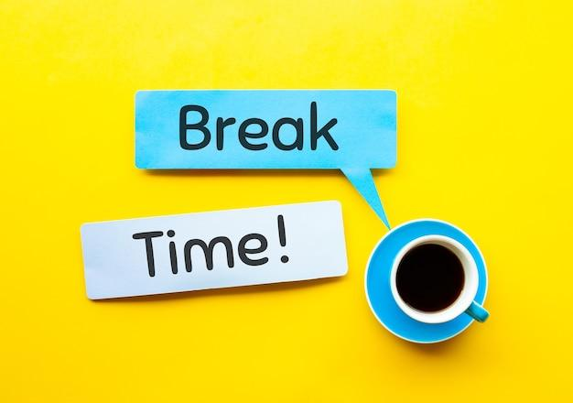
Until about 11:20
Until about 13:10
Notes:
Joriam to do music and stop recording

Slide 18
Next up!
Check in (taste of ecocycle)
Impromptu networking
P2P (taste of)
Matchmaker tool (taste of design storyboards)
Troika
Spiral Journal
Notes:
Joriam finish slide and facilitate
Heather to welcome back, recap the session so far and what next

Slide 19
Share your work so far
In trios, share the first 3 petals of your P2P with colleagues
10 minute time box (3 minutes each!)
N.b. these will be your troika consultant team (so be concise but clear)
Notes:
Joriam finish slide and facilitate/ Heather to support

Slide 20
Selection Matchmaker Select & Sequence LS for a Specific Purpose

Slide 21
LS Matchmaker
(Spreadsheet/Workbook with 4 tabbed pages)
Link to copy for participants to duplicate and use
Link to Kristin’s example - completed sample for review
Notes:
Link to cut and paste into chat - copy for participants https://docs.google.com/spreadsheets/d/1scL2R2hG-RZy9WFlU0WjUq8yrfV-mjpBDH9k4w3cx_4/edit#gid=641335961
Kristin’s example - https://docs.google.com/spreadsheets/d/1v_as6Db9h80BoClIVzb4fneLyFEB7vt7173Tv4jARsI/edit#gid=69571975

Slide 22
LS Matchmaker example - page 1

Slide 23
LS Matchmaker example - page 2

Slide 24
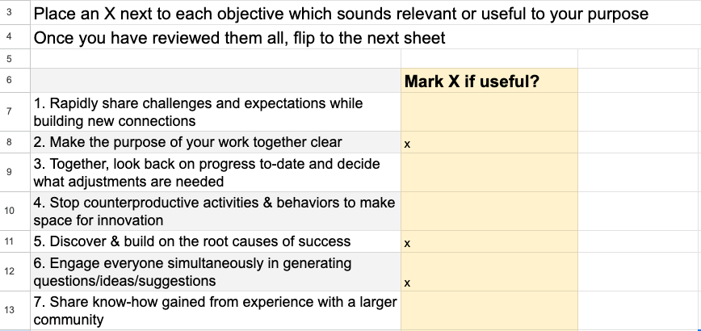
LS Matchmaker - click on spreadsheet link in chat
LS Matchmaker example - page 3

Slide 25
LS Matchmaker example - page 4

Slide 26
Instructions
Take 15 minutes to work independently to transfer what you have developed and complete the 4 pages to the best of your ability
Note: Put a request “move to breakout” to join anyone who would like to have support to complete the matchmaker tool
15 min

Slide 27
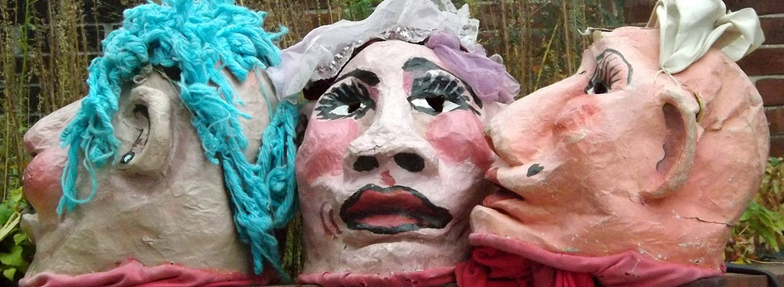
Troika Consultations Get Practical and Imaginative Help from Colleagues Immediately

Slide 28
Instructions & Steps
Return to your trios (1 min)
First ‘client’:
Describe challenge (2 mins)
Consultants ask clarifying questions (3 mins)
Client turns back on consultants and listens as they talk to each other about suggestions, ideas or ways to reframe the challenge (4 - 6 mins)
Client faces consultants and thanks them or follows-up on key items (1 min)
Repeat with each person getting a consultation (10 - 12 mins per round)

Slide 29
This will be a chance to tap into the imaginations of your colleagues, so be bold!

Slide 31
“What do you like about Liberating Structures?”
“What seems important, useful or challenging to you about Liberating Structures
“How do we solve X ”
“Share a story of your journey to, through or from a challenge that you faced while working with groups”
“What should we change about our interaction in groups?”
“What is it that you need to stop doing to deepen or enrich interactions in groups?”
“What is your experience of group work”
“What is your experience with making an impact on a team without being part of it?”

Slide 32
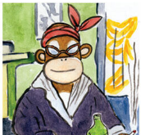
Spiral Journal Calmly prepare for the work ahead while sharpening observational precision. Inspired by Lynda Barry

Slide 33
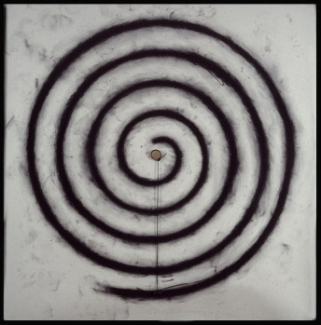
Draw a continuous spiral as slowly & tightly as possible

Slide 34
Following my consultation a reflection or an insight I have on my string/event is…

Slide 35
Following my consultation a reflection or an insight I have on my string/event is…
Resource or support I still need is…

Slide 36
Following my consultation a reflection or an insight I have on my string/event is…
What I hope my session will achieve is…
Resource or support I still need is…

Slide 37
My next step will be…
Following my consultation a reflection or an insight I have on my string/event is…
What I hope my session will achieve is…
Resource or support I still need is…

Slide 39
Today we have
Checked in (taste of ecocycle)
Impromptu networking
P2P (taste of)
Matchmaker tool (taste of design storyboards)
Troika
Spiral Journal
Notes:
Joriam finish slide and facilitate

Slide 40
Wrap and thanks
Feedback - chatfall
More dates
Get involved
Notes:
Matthew

Slide 41
Sample String

Slide 43
Author: Jacob Rasmussen - Scrum Master / Agile Coach

