Slide 1
Q Community Discussion: Safer staffing in community hospitals
Helen Hughes
Chief Executive, Patient Safety Learning
Wednesday 5 April 2023

Slide 2
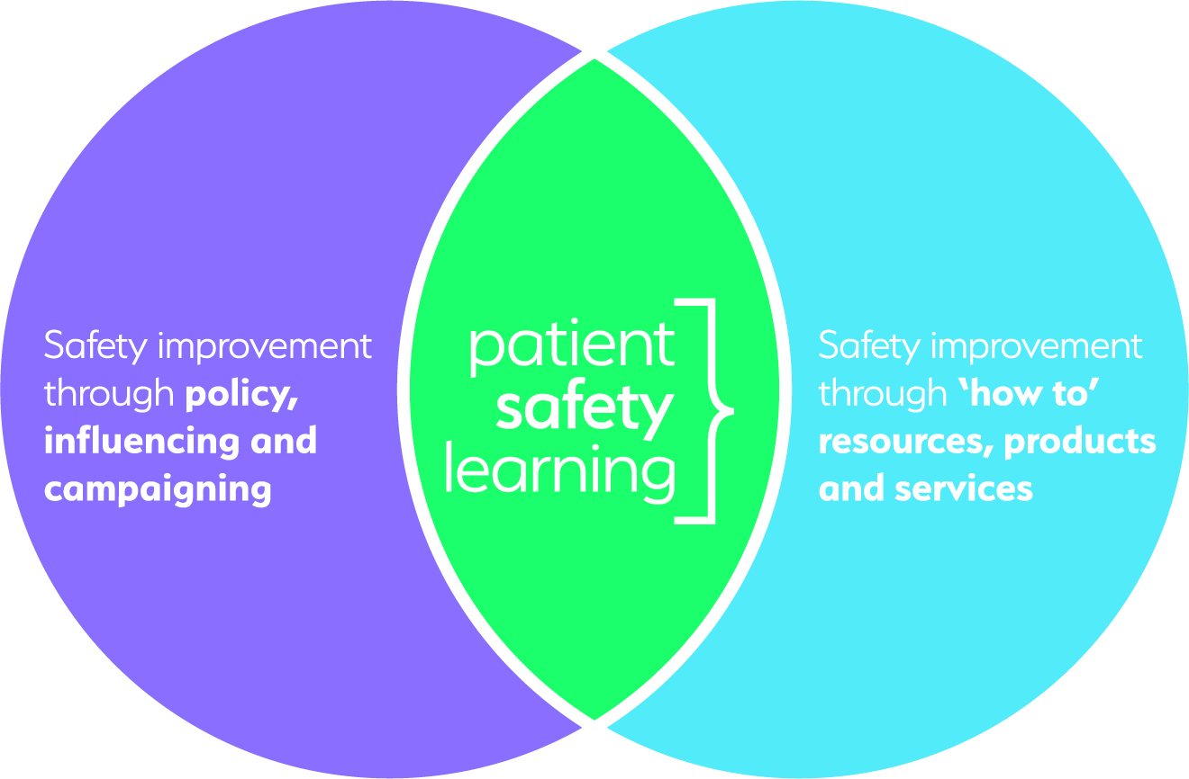
An independent charity for patient safety
An independent voice for transformational change in how health and social care organisations think and act in regard to patient safety.

Slide 3
Scale of avoidable harm in healthcare
Patients want safe and effective care and assume that patient safety is a priority.
Despite the efforts and good work of many people, unsafe care continues to persist.
11,000 | UK avoidable deaths annually. Post pandemic?
3 million | deaths each year worldwide as a result of unsafe care.
15% | of healthcare costs attributable to unsafe care
Have we normalised an unsafe system?

Slide 4
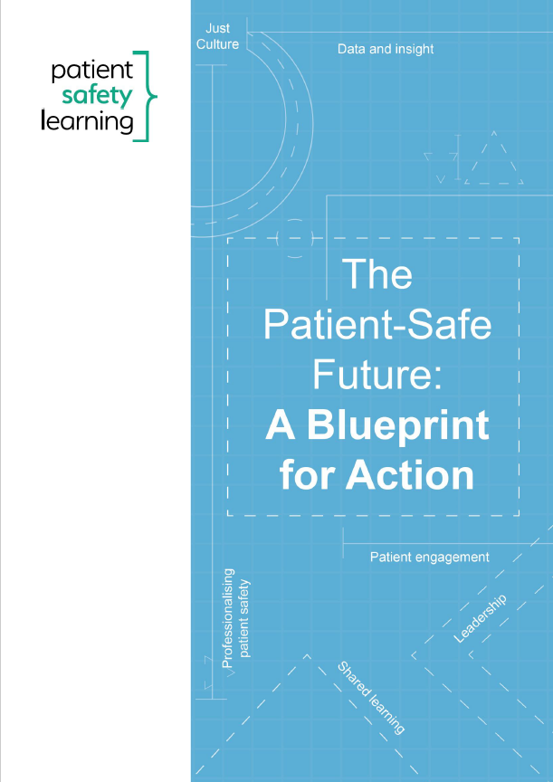
A transformative approach to patient safety
Safety as a core purpose
Leadership commitment
Safety comparison data to drive out variation
Competency framework for all staff
Patient safety and human factors expertise
Patient engagement and co-production
Learning for safety improvement
Safety I and Safety II
A Just Culture; psychologically safe
Design for safety, not just addressing harm

Slide 5
Organisational standards for Patient Safety
Based on a Blueprint for Action
Practical actions to address the foundations of safer care for patients
Underpinned by systemic analysis and evidence
7 foundations for action & safety priorities
26 aims that underpin these
144 standards of what good looks like
Evidence-based outputs
Outcomes, behaviours and actions for successful delivery
Accreditation levels: Essential, Enhanced, Exemplary
Notes:
Built on a 20 year evidence base from reports, Inquiries, policy guidance etc

Slide 6
Staff safety & patient safety: two sides of the same coin
Physical safety eg appropriate PPE
To prevent the risk of infection
Psychological safety when speaking about incidents of unsafe care, near misses and sharing opportunities for improvement
To increases the likelihood that patient safety problems will be identified, reported and addressed
Safe staffing levels
To ensure safe & effective patient care
To avoid problems of burnout that directly impact on the wellbeing and health of staff
Across all care pathways

Slide 7
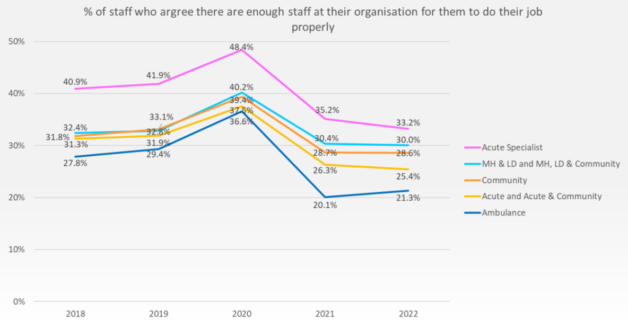
Have we safe staffing levels?
Right numbers of staff, with the right skills, in the right place at the right time
Stark results of 2022 NHS Staff Survey Results
Only 28.6% of respondents from Community Trusts said there are enough staff at their organisation for them to do their job properly

Slide 8
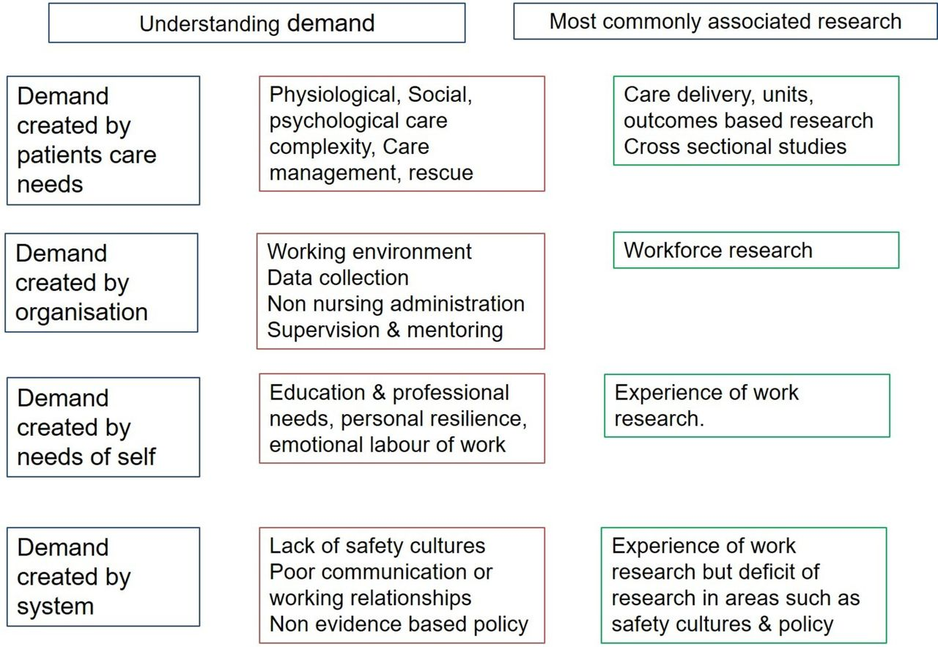
Safe staffing levels
Research highlights the negative impacts on patient outcomes as a result of insufficient staffing levels
Reports such as the Francis report on the Mid-Staffordshire NHS Foundation Trust, make clear links between patient safety incidents and staffing levels
Complex inter-relationship between nurse staffing and various factors such as patient safety
Need for consider safe staffing from a wider operational safety perspective
Alison Leary, and Geoffrey Punshon BMJ Open 2019;9:e025654

Slide 9
Dr Steve Taylor
WHO Director General
April 2023
🆘COMMUNITY HEALTH CARE - COLLAPSE 🆘
2012-23 - population ⬆️7%
GPs ⬇️ 7%
District nurses ⬇️42%
Health Visitors ⬇️30%
Learning Disability Nurses⬇️23%
School Nurses⬇️25%
Nursing home beds ⬇️ 12%
Residential Care home beds ⬇️16%
More joined up thinking needed
Globally, we estimate there will be a shortage of 10 million #healthworkers by 2030
It’s pointless having stuff or tools if you don’t have staffbit.ly/3K6oqnz pic.twitter.com/2XodbMClnm

Slide 10
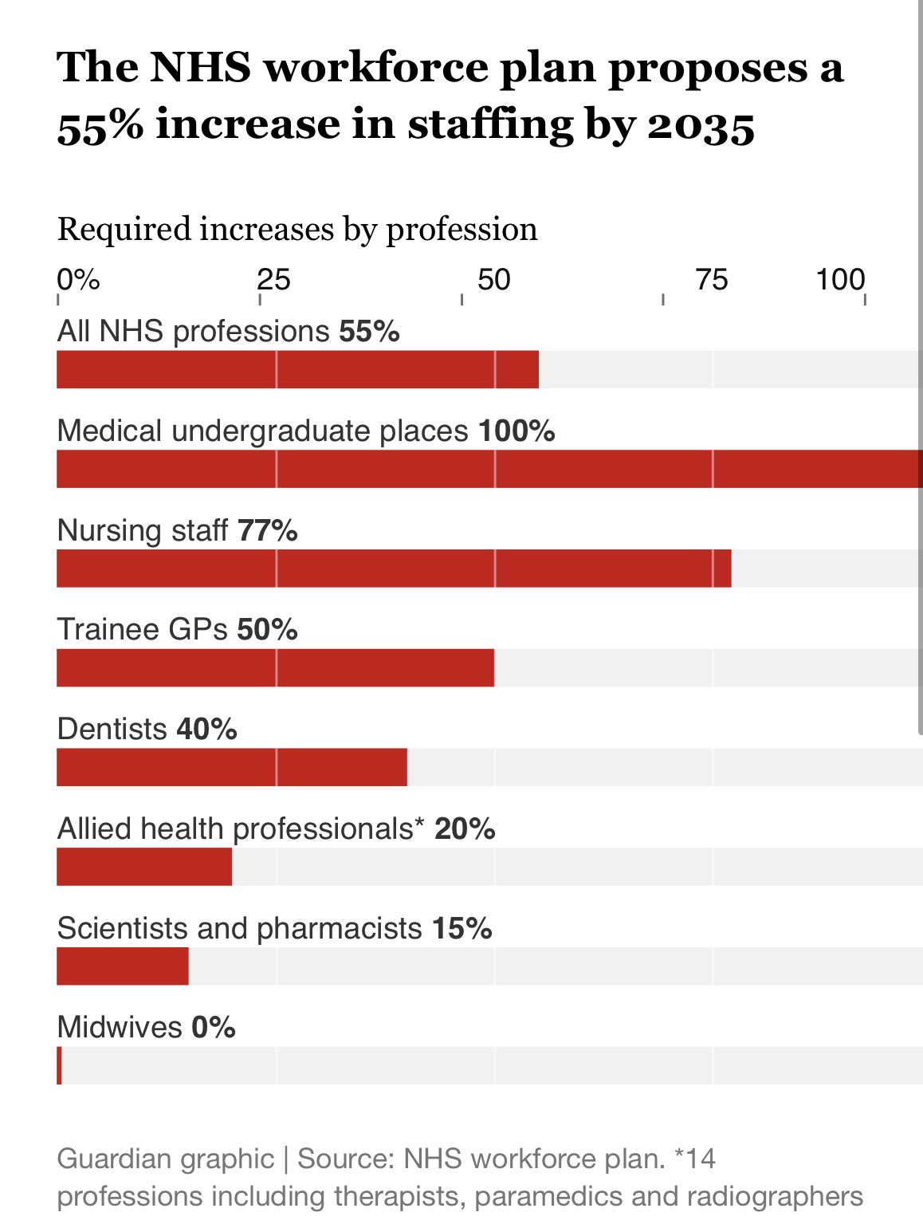
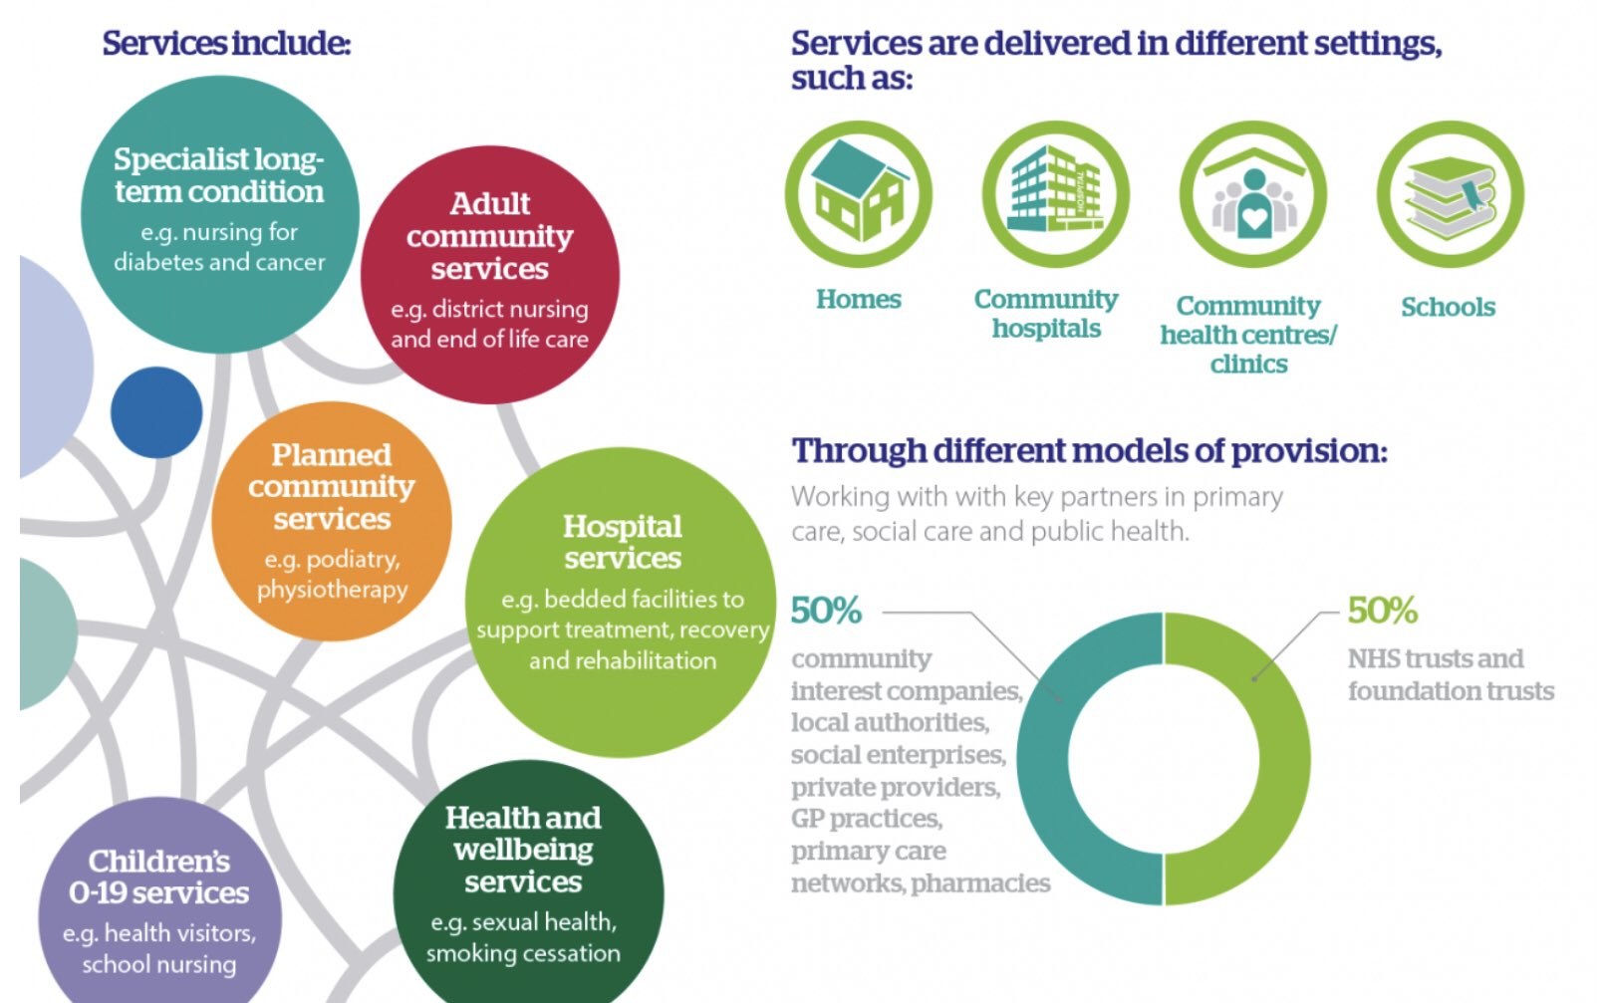
Safe Staffing: NHS workforce plan
Need a fully-funded NHS workforce plan
That incorporates patient safety
Standards for workforce planning
Safe staffing levels to reflect patient acuity, staff availability & skills, models of care and the local context
Now 154k full time staff vacancies
571k fewer by 2036?

Slide 11
Canada workforce plan
Support and retention
Deployment and service delivery
Planning and development

Slide 12
Safe staffing resources
Alison is the global expert here. Do watch this. It’s brilliant!
And check out the hub at Patient Safety Learning on https://www.pslhub.org/learn/improving-patient-safety/workforce-and-resources/safe-staffing-levels/

Slide 13
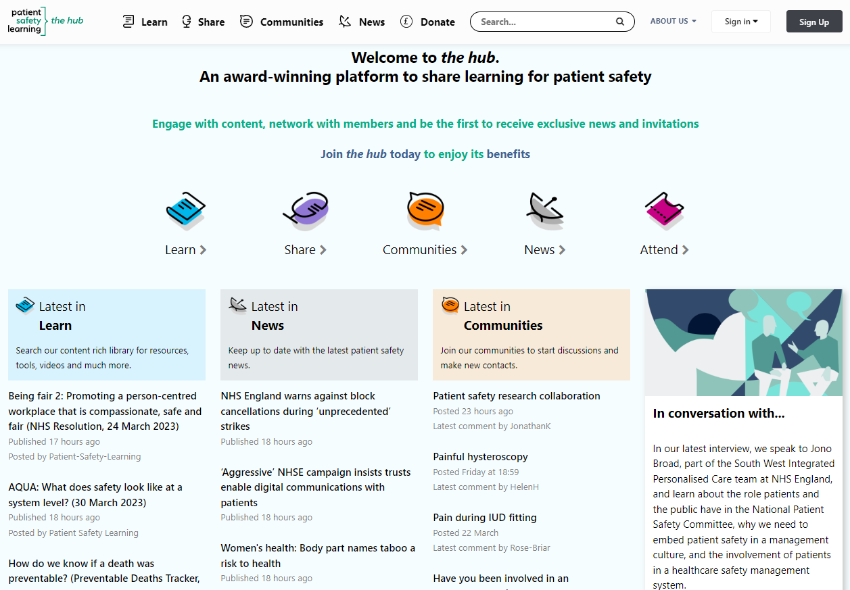
the hub (www.pslhub.org)
Promoting the voice of the ‘patient safety front line’
Sharing knowledge for learning and action through our free patient safety platform
Publishing and promoting high quality content that can be shared to improve patient safety
Promoting patient safety good practice and policy
Notes:
the hub
‘Promoting the voice of the patient safety front line’
Celebrating and sharing good practice
Networks and communities

Slide 14
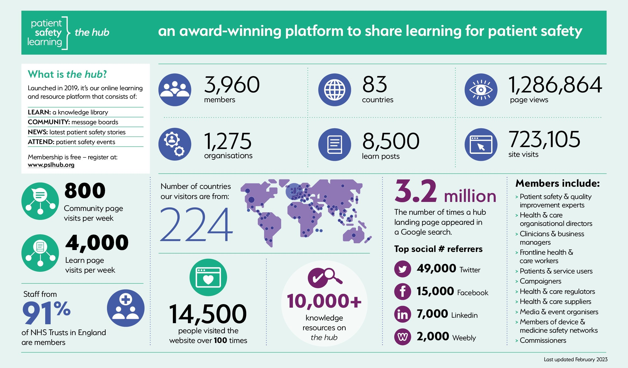

Slide 15
Work with us to create a patient-safe future
Learn and share
Join a community
Become a topic expert
Share your experiences
Patient Safety: a social movement
Email: helen@patientsafetylearning.org
Website: www.patientsafetylearning.org
Twitter: @ptsafetylearn
LinkedIn: Patient Safety Learning
cc: rawpixel - https://unsplash.com/@rawpixel?utm_source=haikudeck&utm_medium=referral&utm_campaign=api-credit
Notes:
helen@patientsafetylearning.org
www.patientsafetylearning.org
Follow us on twitter and LinkedIn
@ptsafetylearn
@helenh49
#share4safety
#pslhub

