Slide 1
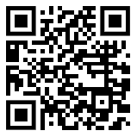
Liberating Structures: TRIZ
What must we stop doing to make progress on the ambitions for palliative care and end-of-life care?

Slide 2
A quick story: correcting a failed rapid discharge
Improvement Quintuple Aim:

Slide 3
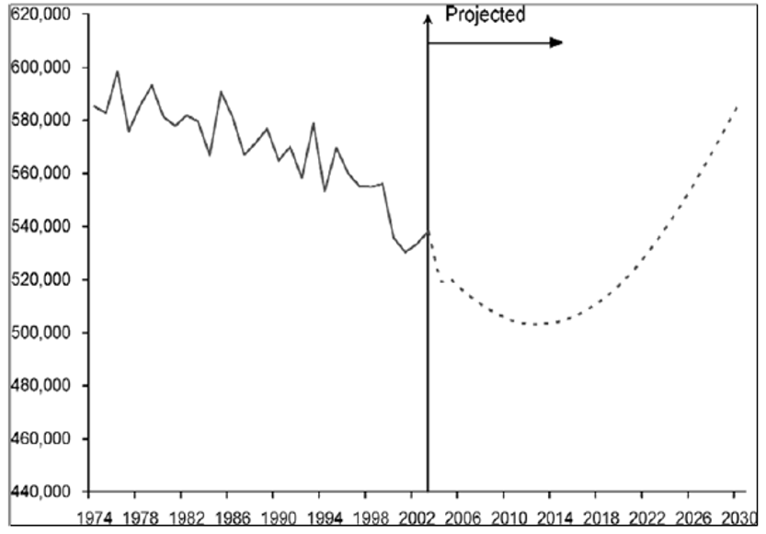
If every death affects 5 people: > 3million affected / year
Indications of Credibility
(Office of National Statistics, 2022)
Notes:
580, 000 deaths / year
= over 48, 000 / month
=11, 000 / week
= over 1500 deaths / day
If 1 death affects seven people…..
That equates to over 11,000 people / day
Over 78, 000/week
Over 335,000 /month
Over 4 million people / year!

Slide 5
Do you want to….
Elevate your problem-solving capabilities?
Unlock new avenues for innovation?
Be empowered in your quest for inventive solutions?

Slide 6
TRIZ
(Theory of Inventive Problem Solving)
"In the abstract world of ideas, everything is possible."

Slide 7
About TRIZ
Offers a systematic framework to identify and resolve contradictions within systems
Enhances creativity and productivity
Facilitates the generation of ideas
Makes space for innovation and uncover novel solutions
TRIZ

Slide 8
Let’s TRIZ- Part I
First alone, then in your group:
Make a list of all we can do to create the most dehumanizing patient experience and delay progress on the ambitions for palliative and end of life care?
Go wild with your thoughts!
Use post it notes -1 idea per post it!
Afterwards, all groups will debrief
8 minutes
TRIZ

Slide 9
Let’s TRIZ- Part II
First alone, then in your group, go through your list and ask:
What are we currently doing that reflects the first list we just created?
Be unforgiving about these items and talk about their impact
After, all groups will debrief
5 minutes
TRIZ

Slide 10
Let’s TRIZ- Part III
As a group, go through your second list from and ask:
What must we stop doing to make progress on the ambitions for palliative care and end of life care, making for a person-centred experience?
Look at themes and generate a list of things to stop and how to stop them
Use post Its for your list
Identify one big idea for action
All groups will come to main room and debrief
5 minutes
TRIZ

Slide 11
Final Thoughts
Let’s Debrief:
What did you notice about TRIZ? What did it make possible?
5 minutes
TRIZ

