Slide 1
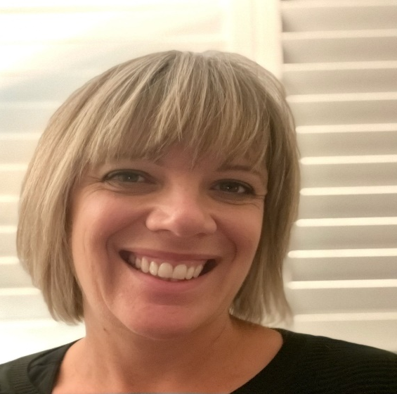
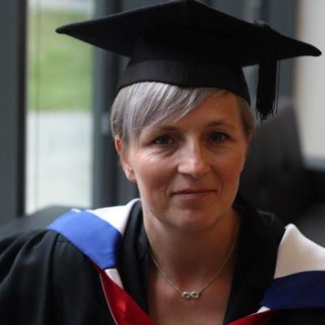
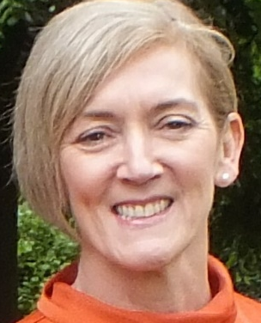
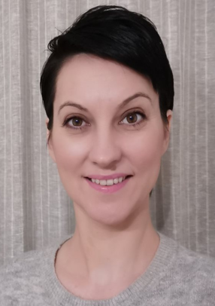
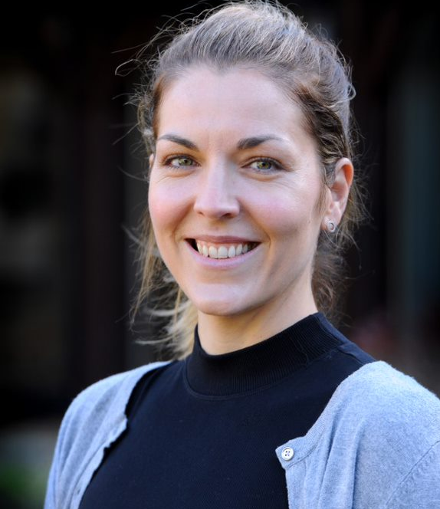
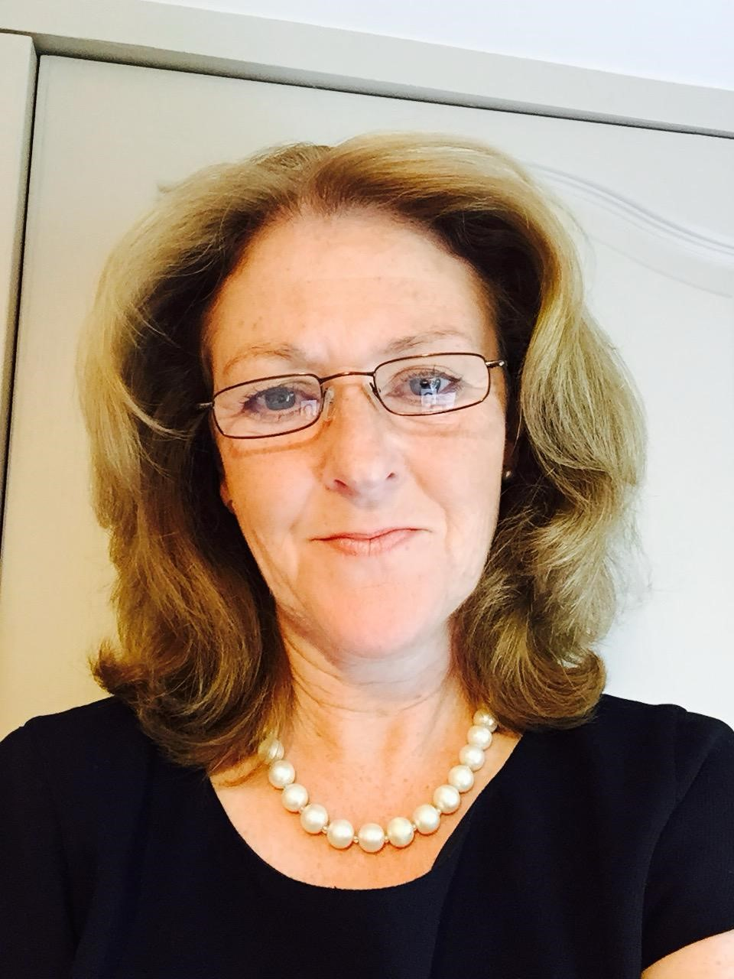
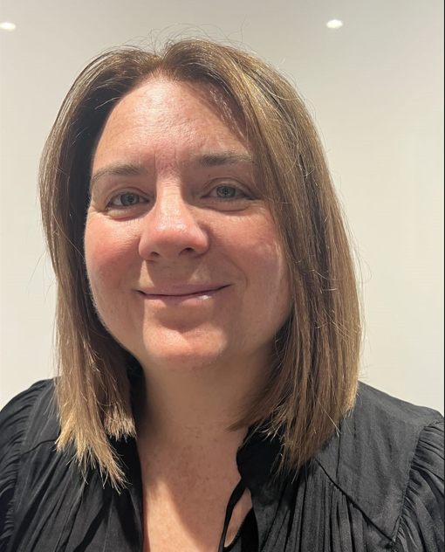
Meet the team
Michelle East
Director of Midwifery at Buckinghamshire Healthcare NHS Trust
Carla Avery
Associate Professor for Midwifery and Lead Midwife for Education (LME)
Eileen Dudley
Senior Programme Lead & MatNeoSIP Lead Health Innovation Oxford and Thames Valley
Anda Bowring
MatNeoSIP Midwifery & Neonatal Clinical Improvement Lead at the John Radcliffe Hospital
Tara Gradwell
Project Support Officer
Health Innovation Oxford and Thames Valley
Jo Lawrence, CEO Back to Life
Fellow of the Higher Education Academy
Educator for the RCUK and ALSG
RCUK Instructor
Executive Board Member RCUK
Coach
Samantha Fleming
Consultant Midwife Royal Berkshire Hospital NHS FT
Notes:
Need to add in SF Photo- Should we add Simcomm Academy here?

